Slide 1
Module 3 – Core Governance Pillars
Data Governance for AI
Notes:
Welcome everyone to the Azure AI Governance workshop. My name is Mahipal Komatreddy, and today we'll explore Data Governance for AI — why it matters, how it differs from traditional data governance, and how Microsoft tools help you implement it end to end.
[SCOPE NOTE] This workshop module focuses specifically on Data Governance topics related to Microsoft Purview Unified Catalog. Other topics such as security controls, identity and access management, encryption, DLP enforcement, and threat protection are covered in a separate Security module outside of this presentation. If attendees raise security-related questions, acknowledge them and redirect to the Security module.

Slide 2
Conditions and terms of use
© Microsoft Corporation. All rights reserved.
You may use these training materials solely for your personal internal reference and non-commercial purposes. You may not distribute, transmit, resell or otherwise make these training materials available to any other person or party without express permission from Microsoft Corporation. URL’s or other internet website references in the training materials may change without notice. Unless otherwise noted, any companies, organizations, domain names, e-mail addresses, people, places and events depicted in the training materials are for illustration only and are fictitious. No real association is intended or inferred. THESE TRAINING MATERIALS ARE PROVIDED “AS IS”; MICROSOFT MAKES NO WARRANTIES, EXPRESS OR IMPLIED IN THESE TRAINING MATERIALS¹
Notes:
Please review the conditions and terms of use for these training materials. These are for your personal internal reference and non-commercial purposes only. Do not redistribute without Microsoft's express permission.

Slide 3
Why Data Governance for AI?
AI creates new data surfaces that traditional governance wasn't designed to handle.
New Data Flows
Training data, vector embeddings, model weights, prompt logs, and inference outputs — each requires governance controls that didn't exist before.
Amplified Risk
A single ungoverned dataset can produce biased models, leak PII at scale, or violate regulations across every AI response.
Regulatory Acceleration
GDPR, HIPAA, NIST AI RMF, ISO 42001, and the EU AI Act (prohibited practices enforced Feb 2025; high-risk AI obligations effective Aug 2026) all demand traceability, explainability, and data accountability for AI systems.
The Purview Approach
Microsoft Purview Unified Catalog provides discovery, classification, lineage, and policy enforcement across the entire AI data lifecycle — from source to response.
Workshop – Azure AI Governance | Data Governance for AI
Notes:
This is the framing slide — set the stage before diving into details. Emphasize that AI governance is NOT just traditional governance rebranded. It introduces entirely new data surfaces (embeddings, model weights, prompt logs) that require new controls. The four bullets build the case: new flows, amplified risk, regulatory pressure, and Microsoft's solution. This slide answers the question every attendee is thinking: why should I care?

Slide 4

Learning Units covered in this Module
 | Data Lineage & Discovery
 | Data Classification & Protection
 | Access & Residency Controls
 | Compliance & Lifecycle Governance
Notes:
This module covers four learning units: Data Lineage and Discovery, Data Classification and Protection, Access and Residency Controls, and Compliance and Lifecycle Governance. Each builds on the previous one, forming a comprehensive governance framework for AI workloads.
[SCOPE NOTE] This workshop module focuses specifically on Data Governance topics related to Microsoft Purview Unified Catalog. Other topics such as security controls, identity and access management, encryption, DLP enforcement, and threat protection are covered in a separate Security module outside of this presentation. If attendees raise security-related questions, acknowledge them and redirect to the Security module.

Slide 5
Data Lineage & Discovery
Mahipal Komatreddy
Notes:
Let's start with our first learning unit — Data Lineage and Discovery. This is the foundation of AI governance: you can't govern what you can't see.

Slide 6

Objectives — Data Lineage & Discovery
After completing this Learning, you will be able to:
 | 1 | Understand…. Data Discovery - Inventory every source feeding the agent Lineage & Provenance - end-to-end traceability from source to AI response
 | 2 | Understand…. F Training Data Governance — consent, licensing, quality, retention Grounding (RAG) Data Governance — index-level permissions, label-aware retrieval
 | 3 | Understand…. Inference Data Governance — prompt/response scanning, zero-retention options
Notes:
By the end of this unit, you'll understand three key areas: first, Data Discovery and Lineage — how to inventory every data source feeding your AI agent and trace data from origin to AI response. Second, Training Data Governance — consent, licensing, quality, and retention. Third, Inference Data Governance — prompt and response scanning and zero-retention options.
[SCOPE NOTE] This workshop module focuses specifically on Data Governance topics related to Microsoft Purview Unified Catalog. Other topics such as security controls, identity and access management, encryption, DLP enforcement, and threat protection are covered in a separate Security module outside of this presentation. If attendees raise security-related questions, acknowledge them and redirect to the Security module.

Slide 7
Data Discovery
Data source inventory — registering every data source an agent may touch (databases, file stores, SharePoint, SaaS APIs, vector stores)
Metadata management — business glossary, data ownership, steward assignments
Asset classification — automatic tagging of sensitive, regulated, or business-critical data
Data quality profiling — completeness, accuracy, freshness, duplication metrics
Notes:
Data Discovery is the starting point. Before you can govern data for AI, you need a complete inventory of every source feeding into your AI agents — databases, file shares, APIs, third-party data feeds. Ask the audience: how many of you have a complete inventory of data sources feeding your AI workloads today?

Slide 8
Lineage & Provenance
End-to-end lineage — from source system → ingestion → transformation → embedding → index → agent response
Impact analysis — what breaks downstream when upstream data changes
Version history — training dataset versions, index refresh versions, model versions
Audit trail — who accessed what data, when, and through which agent
Notes:
Lineage and Provenance answer the question: where did this data come from, and how was it transformed? For AI, this is critical because regulators and auditors need end-to-end traceability — from the original source table all the way to the AI-generated response. Without lineage, you cannot reproduce results or investigate issues.

Slide 9
Microsoft Purview Solution
Notes:
Now let's look at Microsoft Purview — the solution that enables data governance at scale. We'll walk through how Purview's Unified Catalog provides the foundation for everything we just discussed: discovery, lineage, classification, and protection.

Slide 10

Shared platform capabilities
Microsoft Purview
Integrated solutions to secure & govern your entire data estate
DATA SECURITY
DATA GOVERNANCE
DATA COMPLIANCE
Secure data across its lifecycle, wherever it lives
Confidently activate your data & accelerate time to insights
Manage critical risks and regulatory requirements
Data Loss Prevention
Insider Risk Management
Information Protection
Unified Catalog
Data Quality
Data Lineage
Data Health Management
Compliance Manager
eDiscovery and Audit
Communication Compliance
Data Lifecycle Management
Records Management
Unstructured & Structured data
Traditional and AI generated data
Microsoft and Multi-cloud
Shared platform capabilities
AI-based efficiency, Data Map, Classification, Labels, Audit Logs, Policies, Data Connectors
Notes:
Microsoft Purview is your solution for comprehensive security, governance, and compliance on ALL your data wherever it lives. Microsoft Purview combines our solutions for Data Security (for security leaders), Data Governance (for data officers and consumers) and Data Compliance (for risk leaders) into one unified experience and a unified underlying platform. These connected solutions are all anchored on a trusted common foundation to securely navigate and innovate the digital transformation investments. The open platform gives you tremendous choice in terms of solutions you can choose and apply for your needs. ​ This is a huge step in our promise to help you protect your entire data estate. Let’s explore the new Data Governance pillar of Microsoft Purview further.

Slide 11












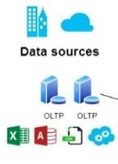
A federated practice paired with user-friendly tools
Data Consumers
Quickly find relevant, trusted datasets and use streamlined workflows to request access.
Domains
Data Owners
Sales
Marketing
Human
Resources
Operations
Finance
Sustainability
Register data assets for use, manage classifications and access, and ensure high quality standards.
Ensure data quality, seamless data discovery, glossary consistency, and lineage. Work with central office.
Data Stewards
Unified Catalog
Data Health Management
Central Data Office
Establish and ensure governance policies, active metadata, compliance, and insights into overall governance health.
Azure
Data Lake Storage
Google Cloud Storage
Databricks
Fabric
Snowflake
Azure
Cosmos DB
Azure
SQLDB
Mongo
DB
Cloud stores and platforms
Databases
All other sources
Notes:
And it’s critical that technology simplifies the way each data professional in your organization manages, discovers, and accesses data. With a solution built for each role, business domain experts can accelerate data value while your data office and stewards provide the standards for consistent operations and can maintain commonalities. It’s all about seamlessly enabling responsible data democratization and federated governance.

Slide 12
Microsoft Purview Unified Catalog
A modern data governance solution that delivers greater business outcomes in the era of AI
Comprehensive visibility
Data confidence
Responsible innovation
Across the data estate with a global catalog of catalogs
Via built-in data quality and data lineage (depending on data source), observability, data estate health and master data management (via partner solution)
With easy discovery of trusted data and access controls
© Copyright Microsoft Corporation. All rights reserved.
Notes:
Microsoft Purview Unified Catalog delivers a modern data governance solution that offers comprehensive visibility by streamlining metadata from disparate catalogs and sources, strengthens data confidence by providing a complete solution that ensures data quality, and empowers day-to-day data consumers to innovate responsibly through easy data discovery experiences in a single control plane —all for greater business value in the era of AI.

Slide 13
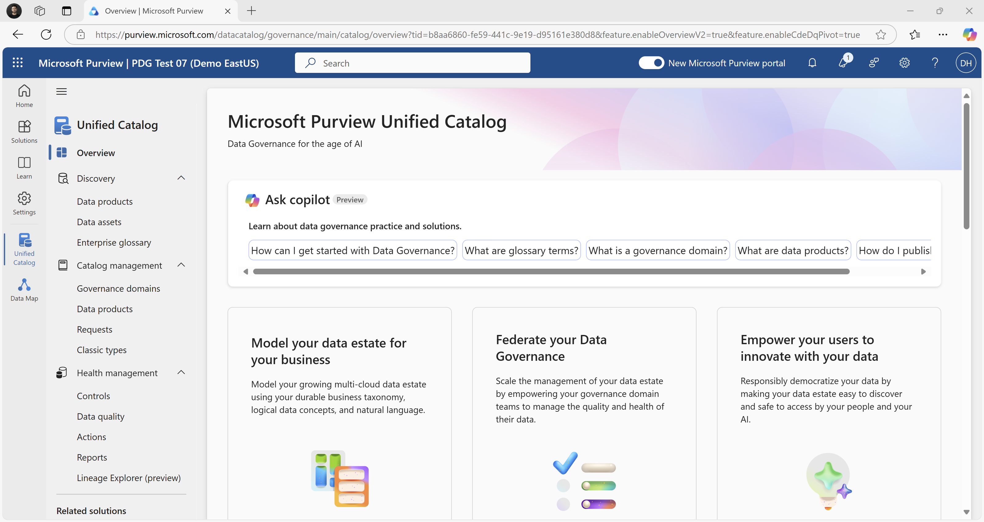
Comprehensive visibility
Comprehensive visibility
Simplify visibility across disparate catalogs, hybrid and multi-cloud environments and data management through a unified experience.
Scan metadata from more than 70 sources across your heterogeneous data estate to enable Data Governance
Data Map
Bring together data discovery, data curation, and data health experiences into one single-pane of glass to enable a culture of federated data governance
Unified Catalog
Enable a responsible marketplace of business-friendly, high quality, and curated assets ready for responsible use.
Data Products
Getting started experience in Microsoft Unified Catalog
13
Notes:
The Unified Catalog simplifies visibility across disparate catalogs, data sources, and data management, via a unified experience across the heterogenous data estate. It empowers users of the catalog to have estate wide governance and complete and actionable oversight of your data estate.

Slide 14
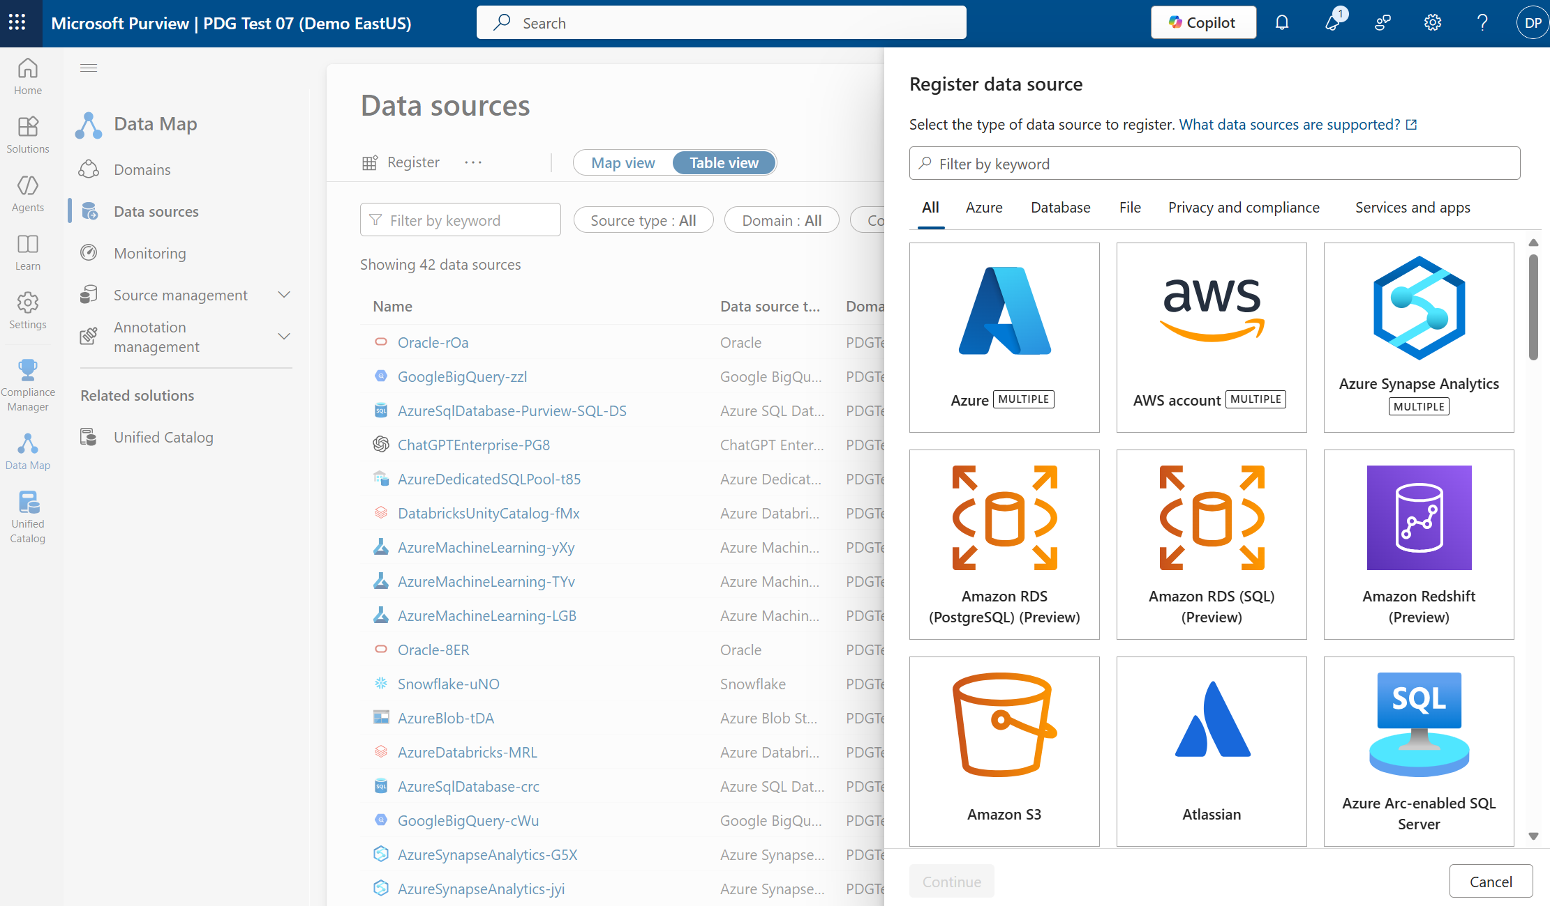
Ingest metadata from 70+ sources into Data Map to build out your Unified Catalog
Ingest metadata from 70+ sources into Data Map to build out your Unified Catalog
Notes:
To begin your data governance journey, Data Map is required to ingest the metadata from your data sources across your data estate. Think of this as the technical layer where data has yet to utilize governance concepts such as glossary terms, data products, governance domains and data quality. The business context that you bring to your data comes from the Unified Catalog

Slide 15
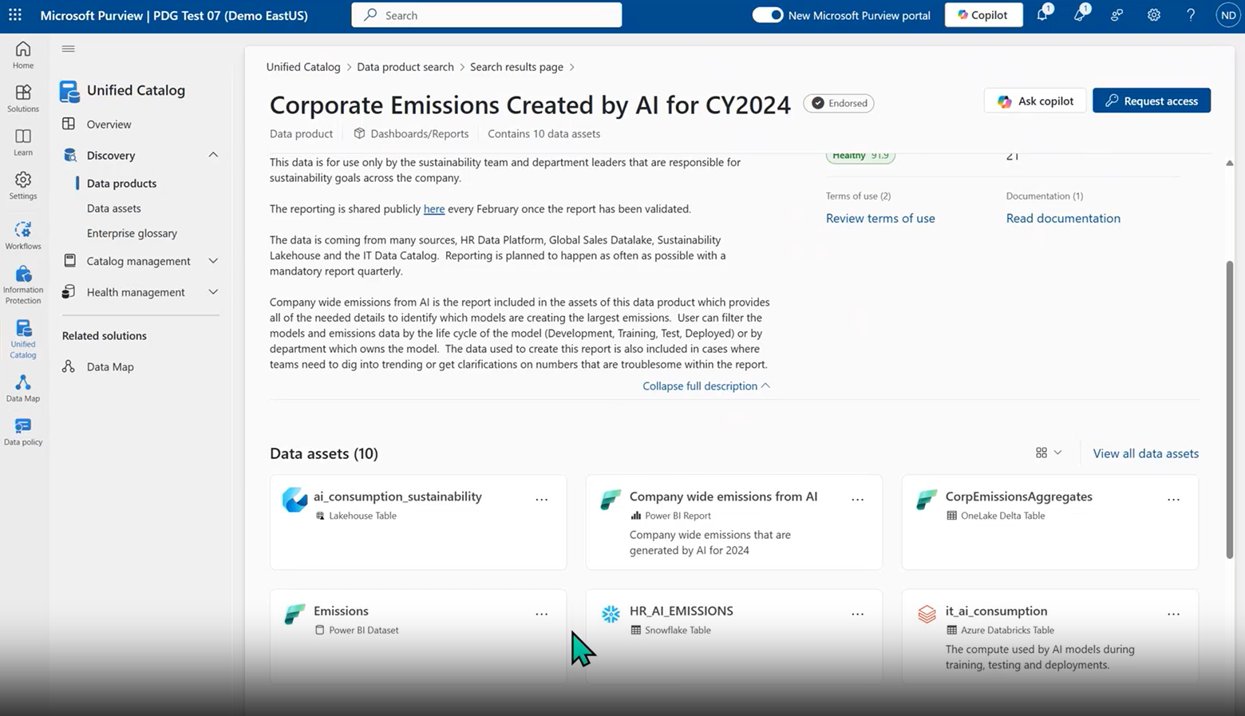
Users see high-level information about each data product as well as individual a
Users see high-level information about each data product as well as individual assets that make up the data product across the data estate
Notes:
One of the governance concepts mentioned prior is data products. With data products you can enable a responsible marketplace of curated, governed, and shareable package of data for responsible use

Slide 16
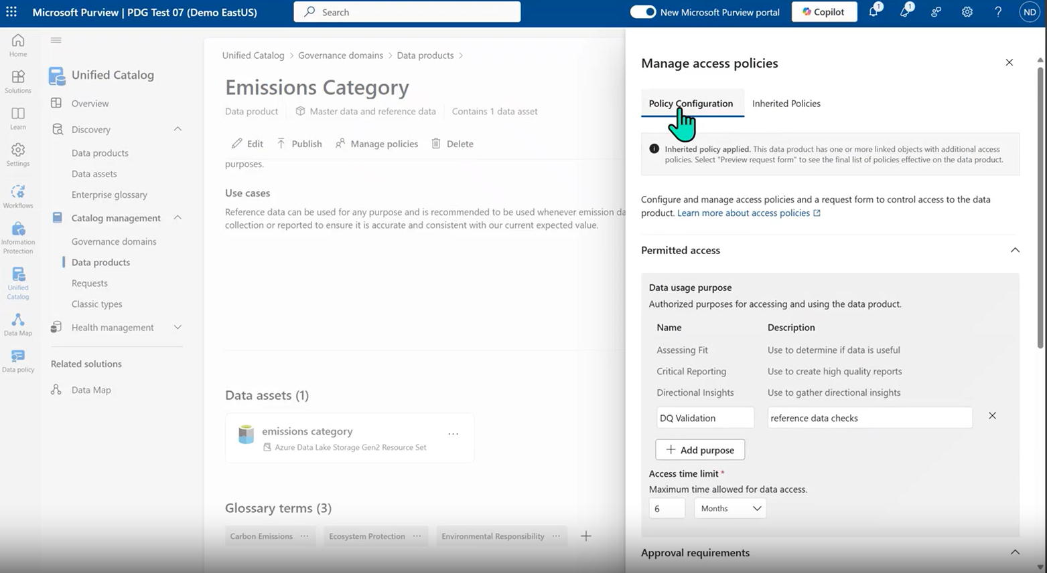
Access Policies streamline the access request process for the business user whil
Access Policies streamline the access request process for the business user while ensuring oversight
Notes:
With access policies, you can streamline the access request process for the business user while ensuring responsible use of data by applying appropriate policies through the data's business context

Slide 17
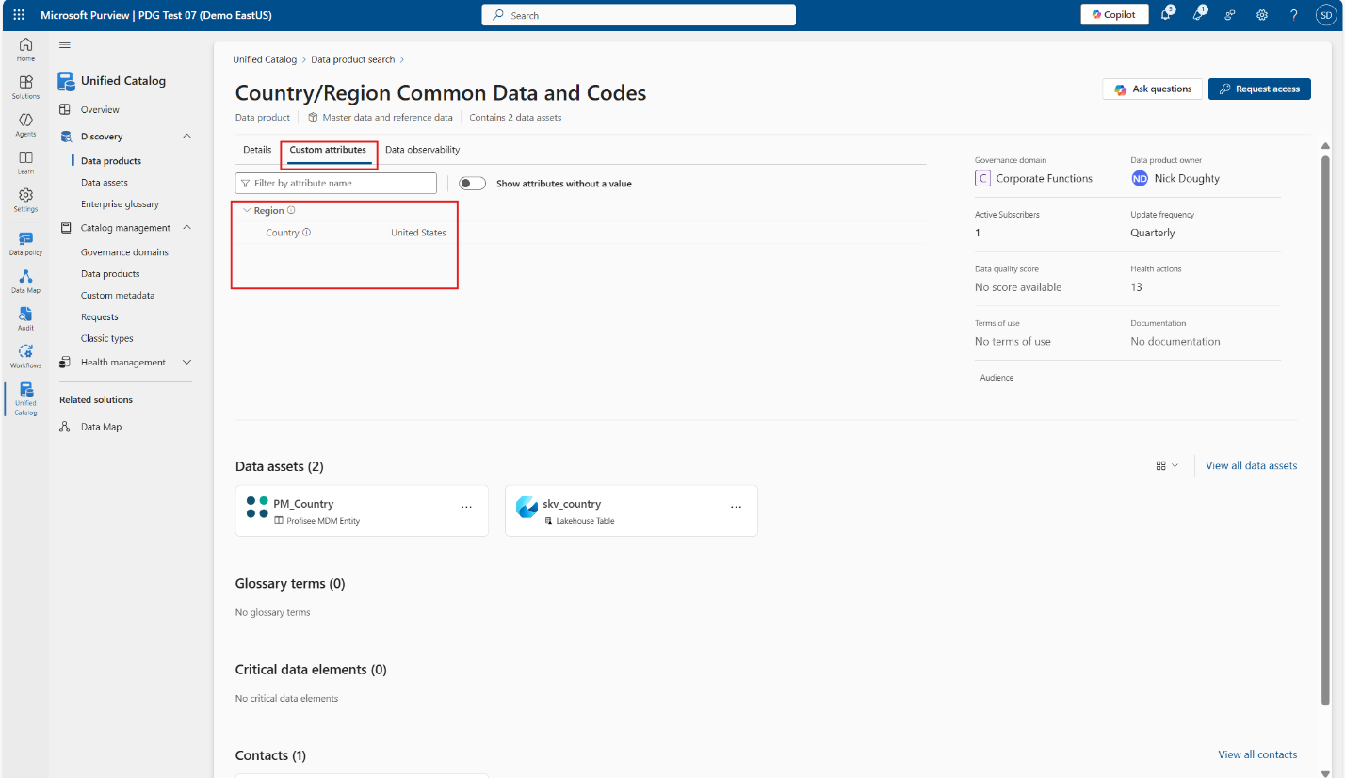
Custom metadata applied to a business concept (data product) that enhances disco
Custom metadata applied to a business concept (data product) that enhances discoverability of assets.
Notes:
Apply user-defined attributes to business concepts—such as data products, glossary terms, CDEs, and governance domains--to capture additional business context for enhanced discovery and curation purposes .

Slide 18
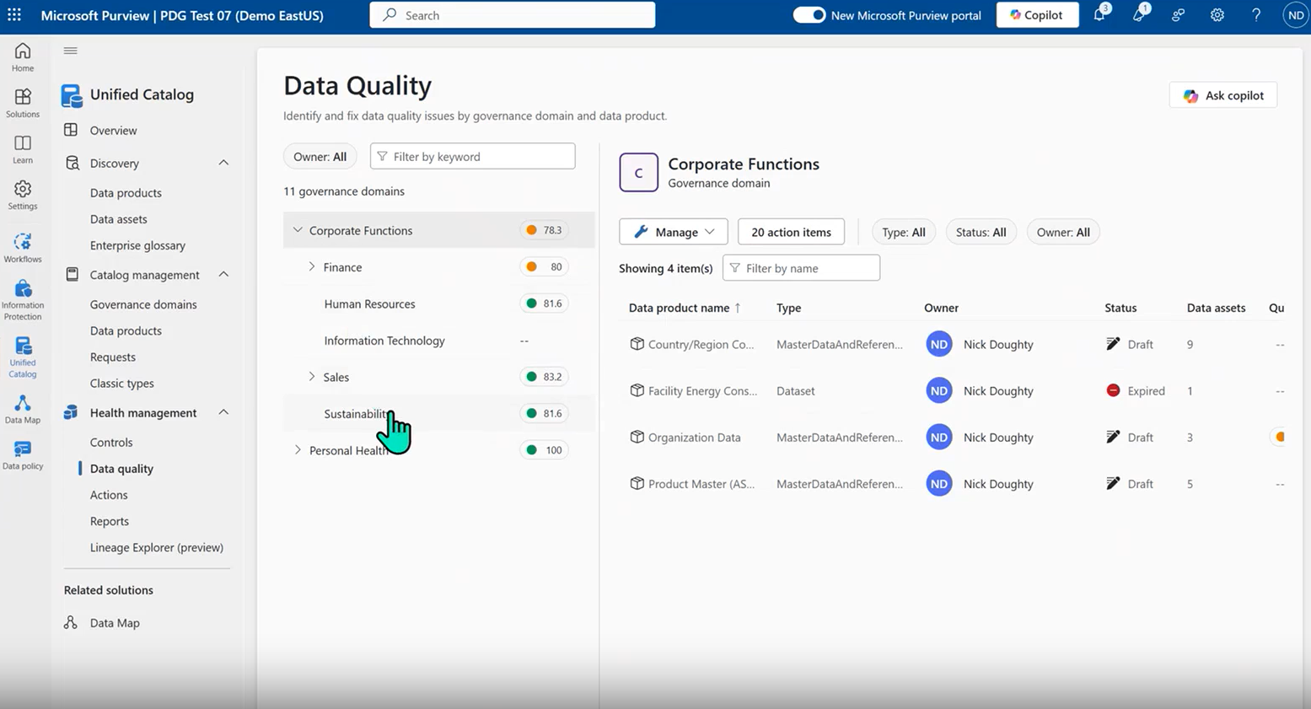
Data confidence
Data confidence
Drive data confidence with built-in data quality and data lineage capabilities aligned to industry standards and policies
Governance domains
Organize your catalog in the way that your organization is set up. Owners can easily manage business concepts at scale within their domains
Understand the relationship between governance concepts and assets in the form of lineage (for a subset of sources) to understand the business impact of data as it is used. Use lineage for auditing and regulation compliance purposes.
Data Observability
Oversee the quality of your data ecosystem (depending on the source), and facilitate targeted actions for improvement
Data Quality
Custom Metadata
Apply attributes to business concepts—such as data products, glossary terms, CDEs-- for enhanced discovery and curation purposes
18
Notes:
Driving data confidence begins with your ability to describe your data and to maintain its data quality. With the Unified Catalog, you can accelerate adoption and speed data value with simplified, business-friendly terms in a platform that anchors to business outcomes and empowers every business user with experiences built for their role. The new Microsoft Purview Unified Catalog experience allows you to explore and understand your data categorized by business domains, search through AI powered copilot, and subscribe to data products that come equipped with all the data you need and the tools to safely access it. In addition, with the Data Health Management capabilities, you can measure, investigate, and improve the health of your entire data estate.

Slide 19
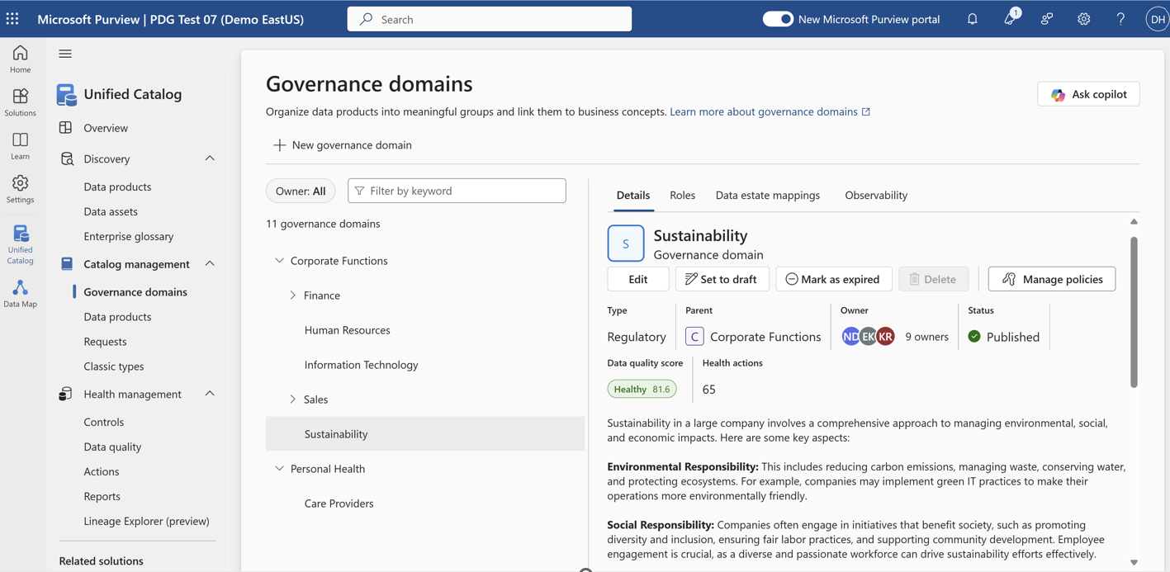
Set up your governance domains to reflect how your organization is structured
Set up your governance domains to reflect how your organization is structured
Notes:
Organize your data effectively and enable data stewards to customize their domains and enable clear categorization to align your governance practice to how your business is structured

Slide 20
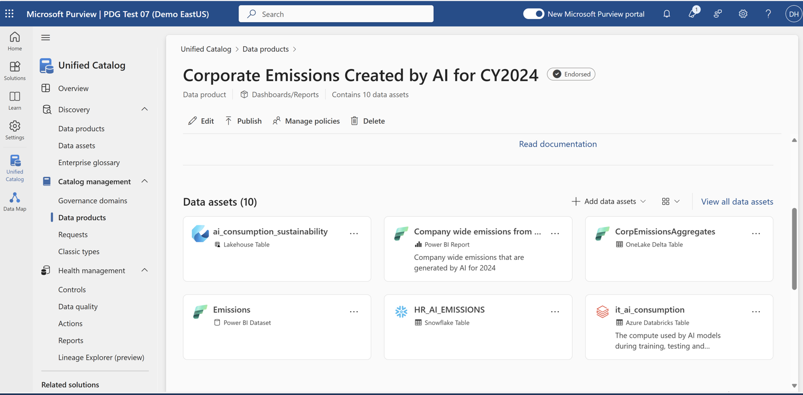
Curated Data products within the catalog drive trust for use by your data consum
Curated Data products within the catalog drive trust for use by your data consumers
Notes:
Access and use groups of assets associated with specific business use cases (data products) and other governance concepts managed by SMEs

Slide 21
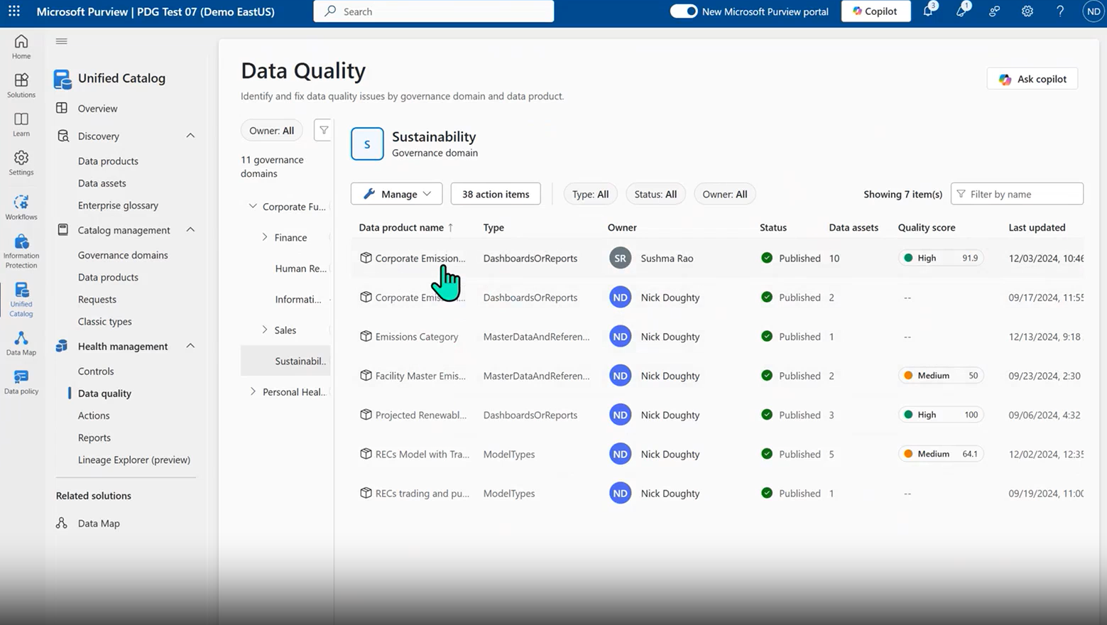
Leverage Data quality to ensure the assets (available for a subset of sources) a
Leverage Data quality to ensure the assets (available for a subset of sources) and associated governance concepts are trustworthy to use
Notes:
With Purview Data Quality, users can oversee the quality of your data ecosystem and facilitate targeted actions for improvement. Without trustworthy data, there's a risk of eroding trust in AI systems and hindering their adoption. Poor data quality or incompatible data structures can hamper business processes and decision-making capabilities

Slide 22
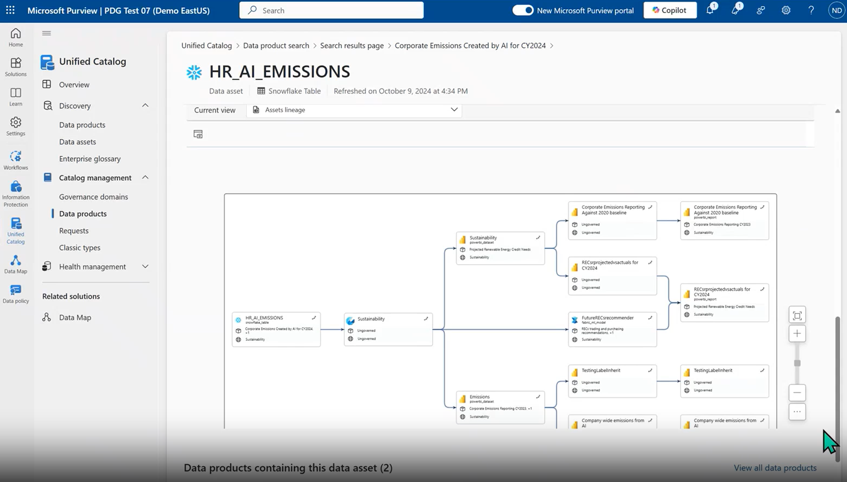
Know where your data goes with Data lineage (available for a subset of sources)
Know where your data goes with Data lineage (available for a subset of sources) and how it is consumed
Notes:
With data lineage, data consumers and owners can understand how data assets are used. An asset in Snowflake can be used in a PBI report or other data workloads. You can also complement lineage within Fabric with Purview Data Lineage.

Slide 23
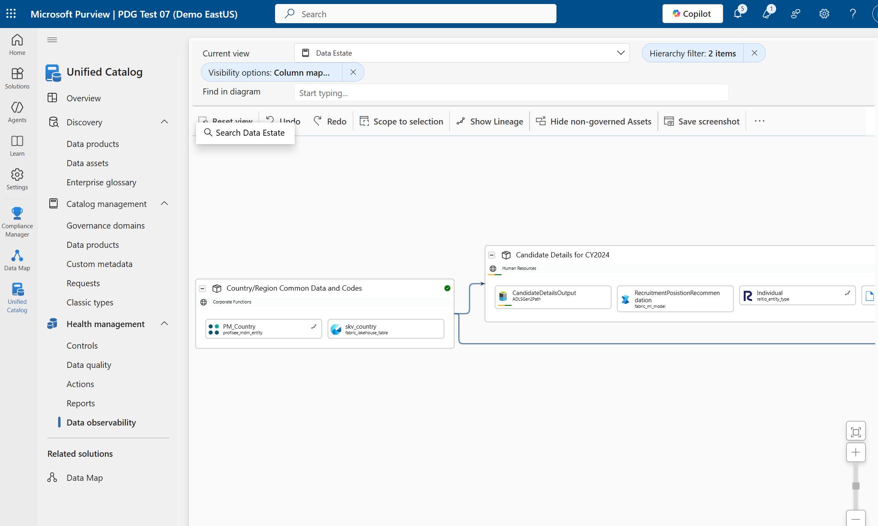
Use Data observability to see the relationship between assets and business conce
Use Data observability to see the relationship between assets and business concepts and how it flows throughout your estate
Notes:
With Data Observability you can enable data stewards, domain owners and data product owners to see the relationship between governance concepts and assets in the form of lineage to understand the business impact of data as it is used and as it moves through out your data estate, bringing business context to data consumption.

Slide 24
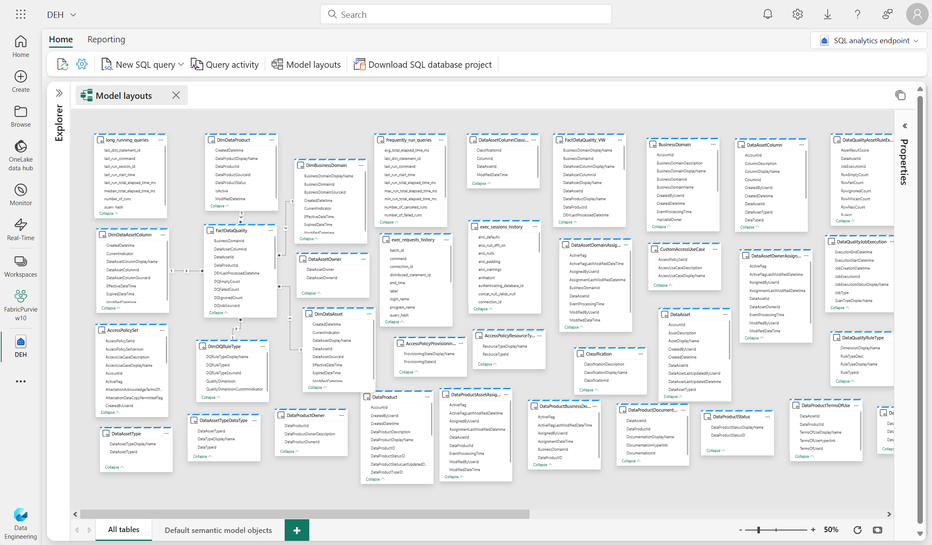
As a data steward, export your metadata with Self-serve analytics into Fabric an
As a data steward, export your metadata with Self-serve analytics into Fabric and use for analytics use cases.
Notes:
Use the rich metadata within the Unified Catalog for analytics in Fabric and Databricks.

Slide 25
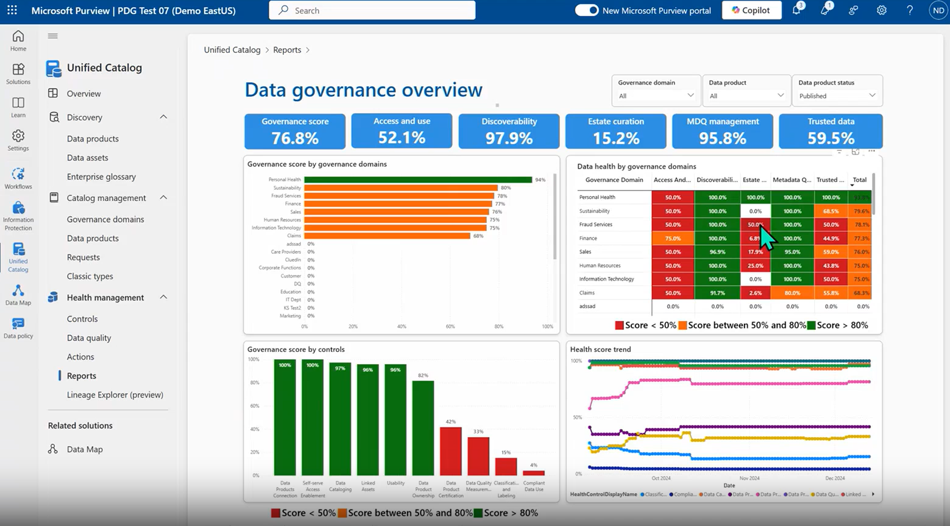
Reports enable Central Data Office to monitor key areas of your data governance
Reports enable Central Data Office to monitor key areas of your data governance practice.
Notes:
Provide pre-built insights and analytics dashboards that help you monitor and optimize your data governance activities with reports. You can check for measurements such as Access and Use, Discoverability, Estate Curation, MDQ management, and more.

Slide 26
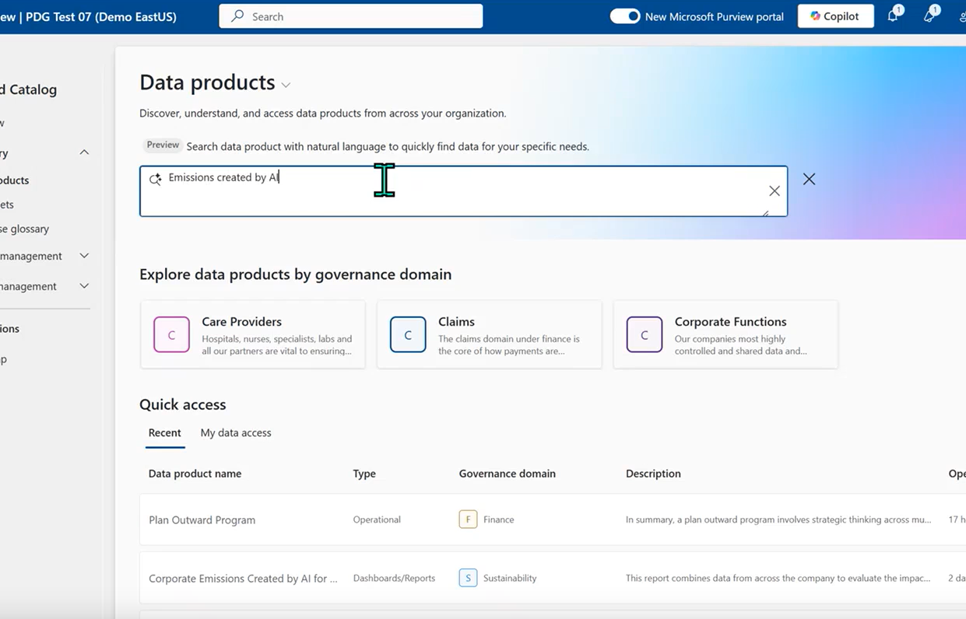
Responsible innovation
Responsible innovation
Responsibly unlock business value with easy data discovery and actionable insights
Simplified discovery
Search using business context and natural language to find data products
Requesting access
Ensure the right people have access to the right data with a flexible permissions model
Self service analytics
Allow organization to take metadata from the Purview Unified Catalog and analyze it in Fabric or Databricks
26
Notes:
Built for day-to-day business users such as data scientists or analysts to responsibly unlock business value with easier data discovery and actionable insights.

Slide 27
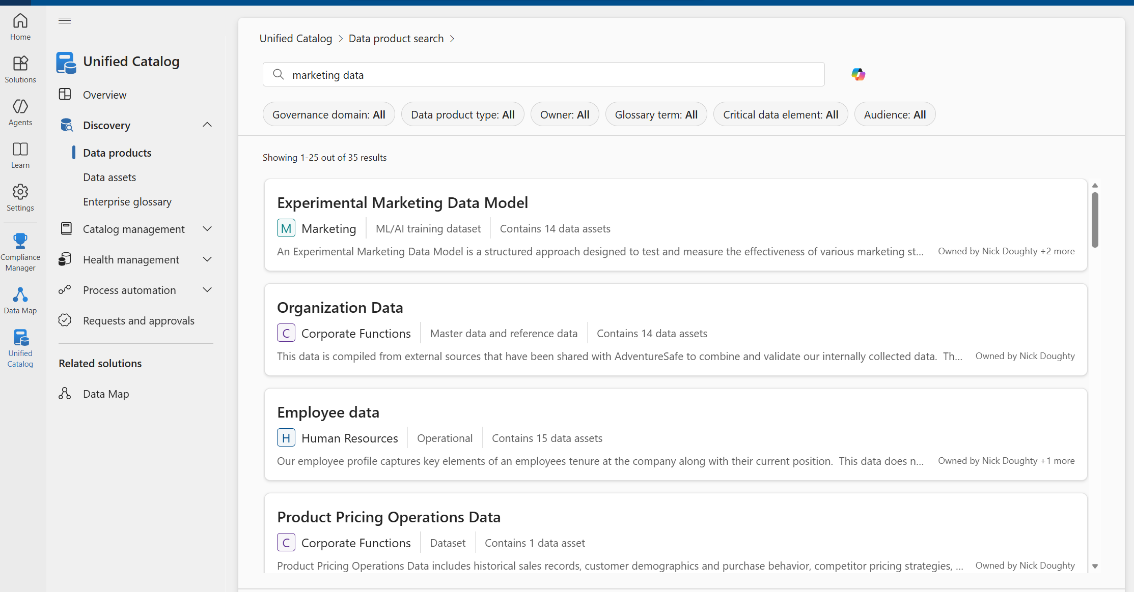
Users can easily search for the data they need to unlock business value
Users can easily search for the data they need to unlock business value
Notes:
With natural language search, business users are empowered to use a catalog for day to day data use cases.

Slide 28
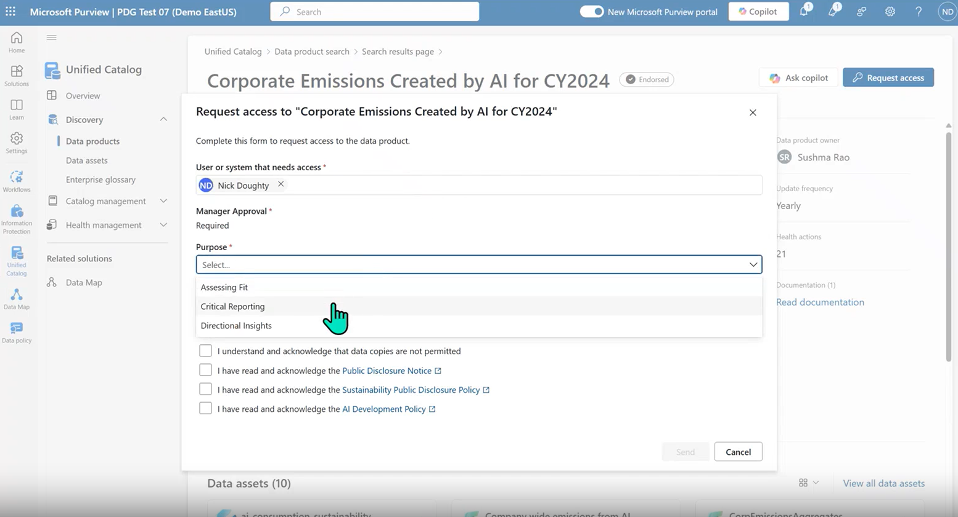
Requesting access is simple and standardized for data users
Requesting access is simple and standardized for data users
Notes:
Ensure the right people have access to the right data through reader and owner level rights with role-based access controls such as requesting access.

Slide 29
Microsoft Purview Unified Catalog for AI
Why is Data Governance essential for AI innovation?
Discover, understand and access data for AI
Ensure data quality for AI
Manage data for AI
Data consumers need to:
Discover AI ready data.
Understand data products and use cases
Have access to AI ready data.
Data owners need to:
Ensure the data that is used in AI is high quality.
Detect data quality issues
Understand data origins and lineage.
Data owners need to:
Manage who has access to AI ready data
Apply terms of use policies
See who has access to data products
Unified Catalog Data Discovery, Data Products, Request Access, Data Quality Score
Data Quality, Data quality rules, Data Observability
Unified Catalog Data Product Management, Manage Requests,
© Copyright Microsoft Corporation. All rights reserved.
Notes:
Data Governance is essential for AI transformation within your organization, especially considering different use cases such as discovering, understanding and accessing data for AI, ensuring data quality for AI, and managing data for AI. Every person within your organization can benefit from Data Governance for AI, depending on the scenario and why they will be using AI.

Slide 30
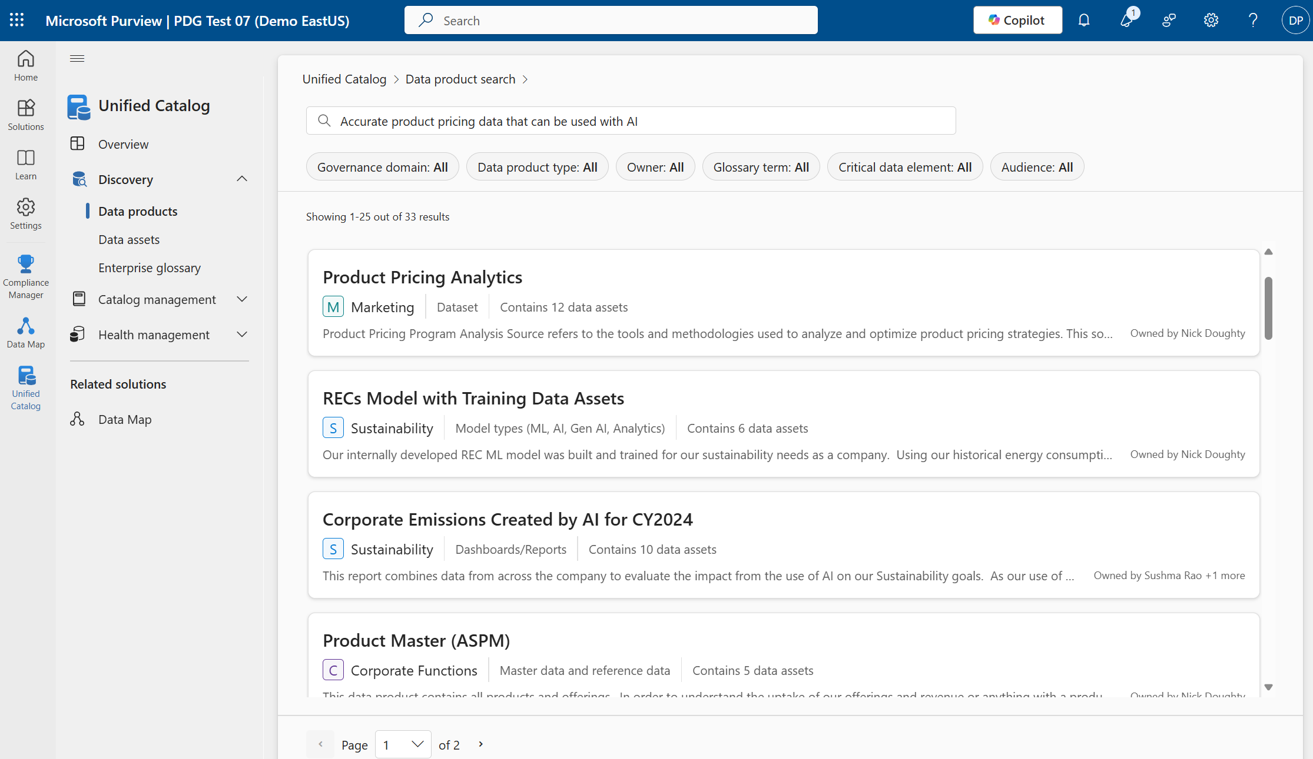
Data consumers can discover AI ready data in the form of data products.
Data consumers can discover AI ready data in the form of data products.
Notes:
Consumers and business users can use the catalog to find AI ready data

Slide 31
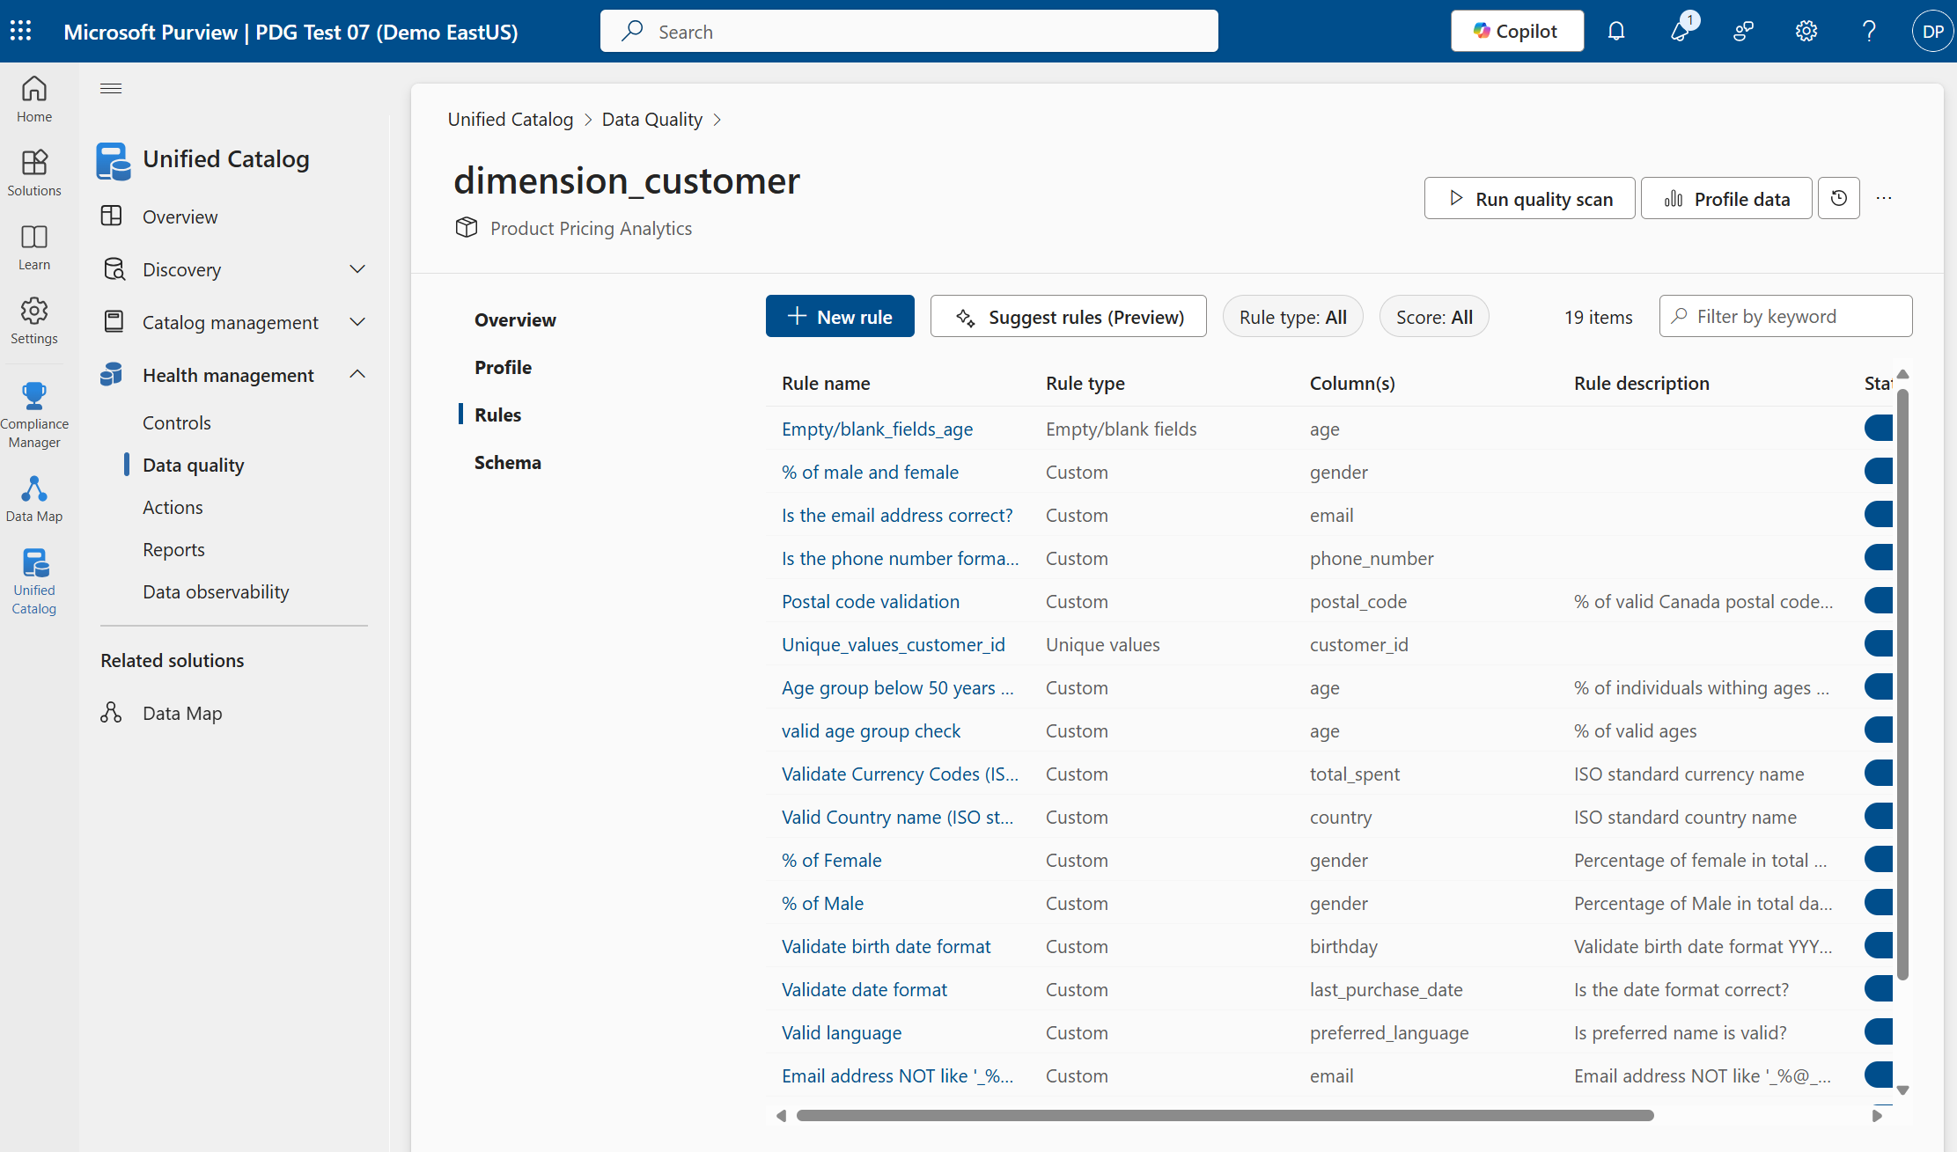
Data owners can apply rules to ensure data quality Is high.
Data owners can apply rules to ensure data quality Is high.
Notes:
Data owners can ensure data quality of assets for AI is accurate and reliable for AI.

Slide 32
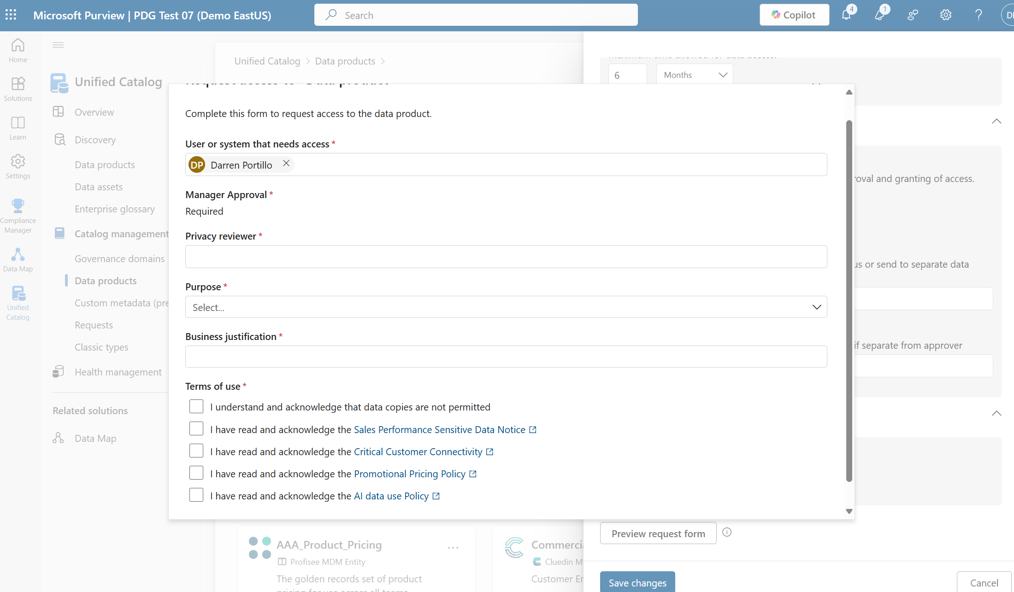
Data owners can apply terms of use AI policies to encourage proper use.
Data owners can apply terms of use AI policies to encourage proper use.
Notes:
Data owners can encourage proper usage for AI via data use policies.

Slide 33
Training Data Governance
Notes:
Transition: We've covered Purview's core capabilities. Now let's see how they apply specifically to training data governance — ensuring the data that trains your models is governed end to end.

Slide 34




Why Training Data Governance Matters
Why Training Data Governance Matters
The model is only as trustworthy as the data it was trained on.
PII / PHI Memorization
Bias & Representation
Models can regurgitate training data — sensitive columns must be redacted or excluded before fine-tuning.
Skewed, stale, or underrepresented data produces biased outputs and regulatory exposure.
Consent & Licensing
Lineage & Reproducibility
Rights to use data for training must be tracked; opt-outs honored per GDPR / CCPA / sectoral rules.
Auditors need to trace every model back to the exact dataset version that trained it.
Training Data Governance | Purview Unified Catalog + Microsoft Foundry
2 / 9
Notes:
This slide captures why training data governance is non-negotiable. The model is only as trustworthy as the data it was trained on. Walk through each risk: PII memorization — models can literally regurgitate sensitive data from training sets. Bias — skewed data produces biased outputs. Consent — you must track rights to use data for training. And lineage — auditors need to trace every model back to its exact training dataset.

Slide 35
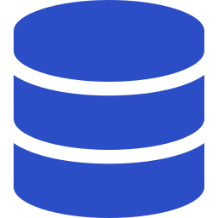






The Training Data Lifecycle
The Training Data Lifecycle
Five governed handoffs from raw data to a registered, compliant model.
1
2
3
4
5
Source
Curate
Label
Train
Register
Raw tables & docs
De-identify & redact
Classify & approve
Fine-tune in Foundry
Governed model card
Microsoft Purview — Data governance
Microsoft Foundry
Source · Curate · Label
Train · Register
Training Data Governance | Purview Unified Catalog + Microsoft Foundry
3 / 9
Notes:
Here we see the five governed handoffs in the training data lifecycle: Source, Curate, Label, Train, and Register. The key point is that governance responsibility spans two platforms — Purview handles the first three stages (source, curate, label) while Microsoft Foundry handles training and registration. The handoff between them must preserve governance metadata.

Slide 36






Purview Unified Catalog — Training Data
Purview Unified Catalog — Training Data
Turn a raw source into an approved, governed training dataset.
Data Products
Auto-Classification
Sensitivity Labels
Register the training set as a versioned, searchable product in the catalog.
Scan columns for PII, PHI, secrets; flag fields that need redaction before training.
Apply 'Training — Approved' labels that follow the data into Foundry.
Quality Rules
Dataset Versioning
Access Policies
Completeness, uniqueness, freshness, and bias checks run on every snapshot.
Snapshot lineage — know exactly which rows trained which model.
Data Reader / Curator scopes gate who can export for training.
Training Data Governance | Purview Unified Catalog + Microsoft Foundry
4 / 9
Notes:
This slide details what Purview Unified Catalog brings to training data governance. Highlight the six capabilities: Data Products for versioned registration, Auto-Classification for PII/PHI scanning, Sensitivity Labels that follow the data into Foundry, Quality Rules for bias and completeness checks, Dataset Versioning for reproducibility, and Access Policies to control who can export data for training.

Slide 37





Microsoft Foundry — Training & Model Gov
Microsoft Foundry — Training & Model Gov
From approved dataset to registered, evaluated, compliant model.
Model Catalog
Managed Fine-Tuning
Evaluations Suite
Versioned model cards with dataset lineage, risk tier, and approval state.
Guardrailed training jobs that honor Purview labels on the input dataset.
Run quality, safety, bias, and groundedness evals on every training run.
Safety Filtering
Approval Workflows
Monitoring
Pre-training filter for harmful content; post-train Prompt Shields applied.
Risk tier drives reviewers — legal, compliance, and Responsible AI sign-off.
Drift, quality, and safety signals from production feed back into the catalog.
Training Data Governance | Purview Unified Catalog + Microsoft Foundry
5 / 9
Notes:
Now the Microsoft Foundry side. Once data leaves Purview, Foundry picks up governance with: a Model Catalog with versioned cards linking back to datasets, managed fine-tuning that honors Purview labels, an Evaluations Suite for quality, safety, and bias testing, safety filtering, approval workflows driven by risk tier, and monitoring that feeds signals back to the catalog.

Slide 38

How Purview and Foundry Integrate
How Purview and Foundry Integrate
One lineage graph — from the source table to the deployed model.
Purview Unified Catalog
Microsoft Foundry
Scans source tables (SQL, Fabric, Snowflake)
Classifies PII / PHI at column level
Applies sensitivity labels to the dataset
Publishes as an approved Data Product
Enforces access via data policies
dataset + labels + lineage
Imports the approved Data Product as input
Runs fine-tuning job with safety filters
Executes evals — safety, bias, groundedness
Creates model card with dataset lineage
Routes for approval & publishes to catalog
Unified lineage: Source column → Data Product → Training run → Model card
Training Data Governance | Purview Unified Catalog + Microsoft Foundry
6 / 9
Notes:
This is the integration slide — arguably the most important in this section. Emphasize the unified lineage graph: Purview scans and classifies source tables, applies labels, publishes as an approved Data Product. Foundry then imports that product, runs fine-tuning with safety filters, executes evaluations, and creates a model card with full dataset lineage. One continuous chain from source column to deployed model.

Slide 39
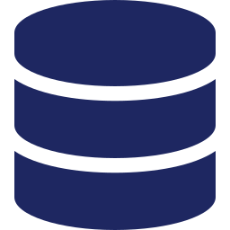





Demo — Governed Fine-Tune in 6 Steps
Demo — Governed Fine-Tune in 6 Steps
From catalog-approved dataset to registered model — end to end.
1
2
3
Publish Data Product
Classify & Label
Quality Gate
In Purview, register curated claims + notes as a Data Product with owners & terms.
Auto-classify PII/PHI; apply 'Training — PHI Approved' sensitivity label.
Run completeness, freshness, and PII-leak checks; fail the build if any fail.
4
5
6
Import to Foundry
Train & Evaluate
Approve & Register
Select the Data Product in Microsoft Foundry; lineage + labels carry over automatically.
Kick off fine-tuning; run safety, bias, and groundedness evaluations on outputs.
Compliance reviewer approves; model card published with full dataset lineage.
Training Data Governance | Purview Unified Catalog + Microsoft Foundry
7 / 9
Notes:
Walk the audience through this six-step demo flow. This is a concrete, end-to-end example: publish a Data Product in Purview, classify and label PII/PHI, run quality gates, import to Foundry, train and evaluate, then approve and register. If doing a live demo, pause here and show each step. If not, walk through the screenshots.

Slide 40
Governance Control Mapping
Governance Control Mapping
Which product owns which training-data control.
CONTROL | PURVIEW UNIFIED CATALOG | MICROSOFT FOUNDRY
PII / PHI detection in training data | Auto-classification with 300+ SITs | Safety pre-filter on fine-tune data
Dataset approval & ownership | Data Product registration & stewards | Model card links back to approved set
Sensitivity labels on training data | Applied + enforced at dataset scope | Honors labels on import / training
Data quality & bias checks | Health Checks & quality rules | Bias & fairness evaluations
Versioning & reproducibility | Dataset snapshots with lineage | Training run + model versioning
Safety & content filtering | Sensitive-content scanning | Content Safety + Prompt Shields
Approvals & audit trail | Access policies + audit log | Approval workflow + run history
Training Data Governance | Purview Unified Catalog + Microsoft Foundry
8 / 9
Notes:
This governance control mapping table is a key reference. It shows clearly which product — Purview or Foundry — owns which control. This is useful for customers who want to understand accountability boundaries. Consider printing this as a handout.

Slide 41
Grounding & Inference Governance
Notes:
Transition: Now we shift from training-time governance to runtime governance — controlling what data the model retrieves (grounding/RAG) and what flows through prompts and responses (inference). These are the controls that protect your users in real time.

Slide 42



Why AI Data Governance Is Different
Why AI Data Governance Is Different
Generative AI creates new surfaces to discover, classify, and protect data that didn't exist before.
Grounding Leakage
Prompt Exposure
Models surface data the user wasn't allowed to see — ACLs must be honored in retrieval.
Employees paste PII, PHI, secrets, or source code into prompts — a new DLP vector.
Hallucinations & Bias
Auditability
Ungrounded answers misinform decisions; content safety must catch unsafe outputs.
Regulators want to know who asked what, which sources were used, and how answers were formed.
AI Data Governance | Grounding / RAG + Inference | Foundry + Purview
2 / 9
Notes:
This slide frames why AI data governance is fundamentally different from traditional data governance. Generative AI creates entirely new attack surfaces: grounding leakage where models surface unauthorized data, prompt exposure where users paste sensitive information, hallucinations that misinform decisions, and new auditability requirements. Ask the audience which of these they've encountered.

Slide 43




The AI Data Lifecycle
The AI Data Lifecycle
Four stages — each needs its own governance controls.
1
2
3
4
Source Data
Grounding / RAG
Prompt / Inference
Response & Audit
Classified & labeled in Purview Unified Catalog
Indexed with ACLs; security-trimmed retrieval
Intercepted for DLP, redaction, safety checks
Logged, filtered, attributed with citations
Governance must follow the data — not live inside a single product.
AI Data Governance | Grounding / RAG + Inference | Foundry + Purview
3 / 9
Notes:
The AI Data Lifecycle has four stages, each requiring its own governance controls: Source Data classified in Purview, Grounding/RAG indexed with ACLs and security-trimmed retrieval, Prompt/Inference intercepted for DLP and safety checks, and Response and Audit logged, filtered, and attributed. The key message: governance must follow the data across all four stages.

Slide 44


Grounding & RAG Governance
Grounding & RAG Governance
Control what the model can see — and how it retrieves it.
Security-Trimmed Retrieval
Label-Aware Grounding
Source Allow / Deny Lists
Enforce source ACLs on every query — users see only what they're entitled to.
Respect sensitivity labels on documents and tables during retrieval.
Whitelist approved knowledge bases; block restricted or personal data sources.
Lineage & Citations
Vector Index Residency
Groundedness Evaluation
Every answer cites its grounding sources — lineage ties back to the catalog.
Keep embeddings in approved regions; encrypt with customer-managed keys.
Score answers against the source — reject responses that aren't grounded.
AI Data Governance | Grounding / RAG + Inference | Foundry + Purview
4 / 9
Notes:
Deep dive into Grounding and RAG Governance. Six critical controls: security-trimmed retrieval to enforce source ACLs, label-aware grounding to respect sensitivity labels, source allow/deny lists, lineage and citations for every answer, vector index residency for data sovereignty, and groundedness evaluation to reject ungrounded responses. Emphasize that without security trimming, RAG can become a data leakage vector.

Slide 45


Inference Data Governance — Controls
Inference Data Governance — Controls
Protect what flows in — and what comes back out.
Inbound — Prompts
Outbound — Responses
Sensitive-data detection on the prompt body
Automatic PII / PHI / secrets redaction
Prompt Shield: injection & jailbreak detection
DLP policy enforcement per app / user
Block paste from labeled Confidential sources
Attribution: who asked, which app, when
Content safety: harm, hate, self-harm, sexual
Protected Material detection (copyrighted text)
Groundedness & citation of retrieved sources
Sensitivity label inheritance in answers
Response logging + retention policy
eDiscovery & insider-risk hooks on transcripts
AI Data Governance | Grounding / RAG + Inference | Foundry + Purview
5 / 9
Notes:
Inference Data Governance covers both sides of the conversation. Inbound: sensitive data detection, PII redaction, prompt shield for injection attacks, DLP enforcement, and attribution logging. Outbound: content safety for harmful content, protected material detection for copyrighted text, groundedness checks, label inheritance, response logging, and eDiscovery hooks. This is the last line of defense.

Slide 46


Microsoft Foundry — Runtime Governance
Microsoft Foundry — Runtime Governance
Built-in controls where prompts, models, and responses actually live.
Content Safety
Groundedness Detection
Protected Material
Harm filters, Prompt Shields, jailbreak & indirect-attack detection.
Flags answers unsupported by retrieved context before they reach the user.
Detects copyrighted text and known code snippets in model outputs.
Model Catalog + Cards
Evaluations Suite
Monitoring & Tracing
Versioned models with usage, risk, and compliance metadata built in.
Quality, safety, and grounding evals on datasets before and after deploy.
End-to-end trace per call — prompts, retrieved docs, tool calls, output.
AI Data Governance | Grounding / RAG + Inference | Foundry + Purview
6 / 9
Notes:
Microsoft Foundry provides the runtime governance layer where prompts and responses actually live. Walk through each capability: Content Safety with harm filters and Prompt Shields, Groundedness Detection that flags unsupported answers before they reach users, Protected Material detection for copyrighted content, the Model Catalog with compliance metadata, the Evaluations Suite, and end-to-end Monitoring and Tracing.

Slide 47




Microsoft Purview — Data & Compliance
Microsoft Purview — Data & Compliance
Cross-tenant data posture, DLP, and audit for every AI interaction.
AI Hub
DLP for Generative AI
Sensitivity-Label Honor
Discover all AI apps in use — sanctioned, third-party, shadow — with risk scoring.
Block sensitive paste into Copilot, ChatGPT, and custom AI apps; mask on output.
Copilot + Foundry respect labels from Purview — no unauthorized grounding.
Insider Risk for AI
Audit + eDiscovery
Unified Catalog Grounding
Detect risky prompts, data exfiltration attempts, and unusual AI usage patterns.
Searchable logs of prompts & responses; legal hold and compliance review built in.
Approved datasets flow into RAG with lineage, quality, and label metadata attached.
AI Data Governance | Grounding / RAG + Inference | Foundry + Purview
7 / 9
Notes:
Microsoft Purview provides the cross-tenant data posture, DLP, and audit layer. Key capabilities: AI Hub for discovering all AI apps in use including shadow AI, DLP for Generative AI to block sensitive data, Sensitivity-Label Honor across Copilot and Foundry, Insider Risk for AI to detect exfiltration attempts, Audit and eDiscovery for legal compliance, and Unified Catalog Grounding to flow approved datasets into RAG pipelines.

Slide 48
Control Mapping — Governance Concern to Feature
Control Mapping — Governance Concern to Feature
Which product owns which control across the AI data lifecycle.
GOVERNANCE CONCERN | MICROSOFT FOUNDRY | MICROSOFT PURVIEW
Ungrounded / hallucinated answers | Groundedness Detection + Evaluations | Catalog quality rules on source data
Sensitive data in prompts | Content safety; prompt moderation | DLP for Generative AI + Insider Risk
Prompt injection / jailbreak | Prompt Shields (direct + indirect) | AI Hub alerting on risky AI apps
Unauthorized grounding access | Azure AI Search security trimming | Sensitivity label enforcement
Copyrighted / protected output | Protected Material detection | Communications compliance review
Audit of prompts & responses | Monitoring + tracing per call | Audit log + eDiscovery + retention
Lineage of grounded answers | Citations + tracing UI | Unified Catalog asset lineage
AI Data Governance | Grounding / RAG + Inference | Foundry + Purview
8 / 9
Notes:
This control mapping table is the companion to the training data table we saw earlier. It maps each governance concern — from hallucinations to prompt injection to audit — to the specific features in Foundry and Purview that address it. This is another excellent reference handout for customers.

Slide 49
Data Classification & Protection
Notes:
Moving to our second learning unit — Data Classification and Protection. Now that we understand discovery and lineage, we need to classify what we've found and protect it appropriately.

Slide 50
Objectives — Data Classification & Protection
After completing this Learning, you will be able to:
 | 1 | Understand…. Sensitivity labelling – Confidential Data
 | 2 | Understand…. PII – Personally Identifiable Information tagging
 | 3 | Understand…. PHI - Protected Health Information tagging
 | 4 | Understand…. Data Loss Prevention (DLP) — block sensitive data from AI pipelines and outputs
 | 5 | Understand…. Encryption & Key Management — CMK for training data, indexes, and model artifacts
Notes:
In this unit, you'll learn about sensitivity labeling for confidential data, PII and PHI tagging, Data Loss Prevention for AI pipelines, and encryption and key management for training data, indexes, and model artifacts.
[SCOPE NOTE] This workshop module focuses specifically on Data Governance topics related to Microsoft Purview Unified Catalog. Other topics such as security controls, identity and access management, encryption, DLP enforcement, and threat protection are covered in a separate Security module outside of this presentation. If attendees raise security-related questions, acknowledge them and redirect to the Security module.

Slide 51
Purview Unified Catalog at a Glance
Purview Unified Catalog at a Glance
One catalog for structured + unstructured data across M365, Azure, Fabric, and third-party clouds.
Unified Data Map
Auto-Classification
Sensitivity Labels
Data Products & Quality
Metadata for SQL, Fabric, Snowflake, Databricks, BigQuery, Oracle, SAP.
Column-level scan using 300+ built-in SITs and custom classifiers.
Same M365 label taxonomy now applied to tables, schemas, and columns.
Business-friendly products, glossary terms, quality rules, and OKRs.
Purview Unified Catalog | Structured Data Demo — PII & PHI
2 / 9
Notes:
Quick overview of Purview Unified Catalog capabilities. It provides a single catalog for structured and unstructured data across M365, Azure, Fabric, and third-party clouds. Highlight the four pillars: Unified Data Map, Auto-Classification with 300+ built-in sensitive information types, Sensitivity Labels extending the M365 taxonomy to data assets, and Data Products with quality rules.

Slide 52


PII vs PHI — Know the Difference
PII vs PHI — Know the Difference
Both are regulated — but they live under different frameworks and require different controls.
PII — Personally Identifiable Info
PHI — Protected Health Info
Any data that can identify a specific individual — alone or combined.
Health data linked to an individual, handled by covered entities.
Names, addresses, phone, email
SSN, passport, driver's license
Credit card, bank account
IP address, device IDs
Frameworks: GDPR, CCPA, LGPD
Diagnoses, treatments, Rx
Medical record & account numbers
Insurance / payer information
Lab results, imaging, biometrics
Frameworks: HIPAA, HITECH
Microsoft Purview | PII & PHI Data Classification
4 / 8
Notes:
This is an important distinction that many people confuse. PII — Personally Identifiable Information — is any data that can identify a specific individual, governed by GDPR, CCPA, and LGPD. PHI — Protected Health Information — is health data linked to an individual, governed by HIPAA and HITECH. Both are regulated but under different frameworks with different controls. Your governance strategy must handle both.

Slide 53

How Purview Classifies Data
How Purview Classifies Data
Four complementary techniques — from pattern matching to machine learning.
Sensitive Info Types (SITs)
Trainable Classifiers
Regex + keyword + checksum patterns. 300+ built-in for PII/PHI (SSN, DEA, ICD-10, MRN).
ML models trained on sample docs — detect intent & context (e.g., HR, medical records).
Exact Data Match (EDM)
Sensitivity Labels
Hashed lookups against your own data (patient list, employee roster) for near-zero false positives.
Applied manually, by policy, or automatically on match — drive encryption, DLP, and retention.
Microsoft Purview | PII & PHI Data Classification
5 / 8
Notes:
Purview uses four complementary classification techniques. Sensitive Information Types use regex and keyword patterns — 300+ built-in for PII and PHI. Trainable Classifiers use ML models trained on sample documents. Exact Data Match does hashed lookups against your own data for near-zero false positives. And Sensitivity Labels can be applied manually, by policy, or automatically on match. Together these provide defense in depth for classification.

Slide 54
Built-in Sensitive Information Types
Built-in Sensitive Information Types
A sampler of out-of-the-box detectors you can use today — no custom code required.
SIT NAME | CATEGORY | DETECTS | REGION / FRAMEWORK
U.S. Social Security Number | PII | 9-digit SSN with format + checksum | U.S. (GDPR / CCPA)
Credit Card Number | PII | PAN w/ Luhn validation (Visa, MC, AmEx) | Global (PCI-DSS)
EU Passport Number | PII | EU member state passport patterns | EU (GDPR)
U.S. / U.K. Medical Record Number (MRN) | PHI | Keyword + numeric pattern | U.S. / U.K. (HIPAA)
DEA Number | PHI | Prescriber registration format + checksum | U.S. (HIPAA / DEA)
ICD-10 / ICD-9 Codes | PHI | Diagnostic code patterns + keyword proximity | Global (HIPAA)
Tip: combine multiple SITs into a single policy for high-confidence PHI matches (e.g., MRN + ICD-10 + patient name).
Microsoft Purview | PII & PHI Data Classification
6 / 8
Notes:
Here's a sampler of out-of-the-box Sensitive Information Types. Point out specific examples: SSN with format validation, credit cards with Luhn checks, EU passport patterns, medical record numbers, DEA numbers, and ICD-10 diagnostic codes. The tip at the bottom is important: combine multiple SITs in a single policy for high-confidence matches, such as MRN plus ICD-10 plus patient name.

Slide 55







Demo Architecture
Demo Architecture
Sources → scan → classification → label → catalog → protection.
Azure SQL
Fabric
Snowflake
Purview
Claims DB
Lakehouse
Analytics
Unified Catalog + Data Map
Scan
Classify
Label
Lineage
Protect
Rule set: PII+PHI
Column-level SITs
Confidential — PHI
Propagate downstream
DLP + access policies
Consumers: Data Stewards • Analysts • DLP Engine • Purview Policies • Copilot for Security
Purview Unified Catalog | Structured Data Demo — PII & PHI
3 / 9
Notes:
This is the demo architecture. Walk through the flow: sources including Azure SQL, Fabric Lakehouse, and Snowflake feed into Purview Unified Catalog via scanning. The scan applies PII and PHI rule sets, classifies at column level, labels as Confidential-PHI, propagates lineage downstream, and enforces DLP plus access policies. The consumers at the bottom show who uses this governed data.

Slide 56

Prerequisites & Setup
Prerequisites & Setup
What you need before the demo kicks off.
Environment
Roles & Permissions
Purview account with Unified Catalog enabled
Data sources registered in a Collection
Azure SQL DB with sample claims + patients tables
Fabric lakehouse with bronze/silver/gold layers
Managed identity or SP with Reader on data sources
Sensitivity label taxonomy published from M365
Collection Admin — manage sources & scans
Data Source Admin — register Azure SQL / Fabric
Data Curator — apply labels, glossary, classifications
Data Reader — search catalog, view lineage
Compliance Admin (M365) — publish label policies
Information Protection Admin — auto-label policies
Purview Unified Catalog | Structured Data Demo — PII & PHI
4 / 9
Notes:
Before the demo, ensure these prerequisites are in place. On the environment side: a Purview account with Unified Catalog, registered data sources, Azure SQL DB with sample data, Fabric lakehouse, managed identity, and published sensitivity labels. On the roles side: Collection Admin, Data Source Admin, Data Curator, Data Reader, Compliance Admin, and Information Protection Admin. This is your checklist.

Slide 57
Demo Dataset — Claims & Patients
Demo Dataset — Claims & Patients
Two tables in Azure SQL that should trigger both PII and PHI detectors on scan.
TABLE.COLUMN | TYPE | EXPECTED CLASSIFICATION | CATEGORY
dbo.Patients.FullName | nvarchar | Person Name | PII
dbo.Patients.SSN | char(11) | U.S. Social Security Number | PII
dbo.Patients.DOB | date | Date of Birth | PII
dbo.Patients.MRN | varchar(20) | U.S. Medical Record Number | PHI
dbo.Claims.DiagnosisCode | varchar(10) | ICD-10 Code | PHI
dbo.Claims.PrescriberDEA | char(9) | DEA Number | PHI
dbo.Claims.ClaimAmount | decimal(12,2) | — | None
Result: 6 of 7 columns auto-classify on first scan. The Claims.ClaimAmount column stays unclassified.
Purview Unified Catalog | Structured Data Demo — PII & PHI
5 / 9
Notes:
This is the demo dataset — two tables in Azure SQL. The Patients table has FullName, SSN, DOB, and MRN. The Claims table has DiagnosisCode, PrescriberDEA, and ClaimAmount. Six of seven columns should auto-classify on first scan. Only ClaimAmount stays unclassified since it's a numeric field with no PII or PHI significance. Point this out to show classification accuracy.

Slide 58



Demo Flow — Six Steps in the Catalog
Demo Flow — Six Steps in the Catalog
From source registration to a labeled, searchable, policy-governed asset.
1
2
3
Register Source
Build Scan Rule Set
Run First Scan
Add Azure SQL and Fabric into Purview Collection with managed identity.
Enable PII + PHI system classifications; add custom SITs for MRN format.
Trigger an incremental scan; watch column-level classifications appear.
4
5
6
Apply Sensitivity Label
Catalog Search
Attach a Policy
On dbo.Patients & dbo.Claims, apply 'Confidential — PHI' at table level.
Filter all assets by label = PHI; show cross-source view (SQL + Fabric).
Bind DLP + access policy to the label; restrict export and mask columns.
Purview Unified Catalog | Structured Data Demo — PII & PHI
6 / 9
Notes:
Walk through the six demo steps: Register the Azure SQL and Fabric sources, build a scan rule set with PII and PHI classifications enabled, run the first scan and watch column-level classifications appear, apply the Confidential-PHI sensitivity label at table level, search the catalog filtering by PHI label to show cross-source results, and finally attach a DLP plus access policy to the label. Each step builds on the previous one.

Slide 59

Sensitivity Label — 'Confidential — PHI'
Sensitivity Label — 'Confidential — PHI'
One label. Applied from the Unified Catalog. Enforced end-to-end.
Label Anatomy
Downstream Enforcement
Configured once in Purview Compliance, reused everywhere.
The same label triggers protection across every surface.
Scope: Files, Emails, Schematized data assets
Encryption: Permission = Co-Author for HR-PHI group
Content marking: Watermark "PHI — Handle Per HIPAA"
Auto-labeling condition: MRN + ICD-10 + Name
Downgrade: Requires justification + audit event
DLP Blocks copy to non-HIPAA locations
Access Policy Row- and column-level masking in SQL
Power BI Inherits label, enforces export rules
Insider Risk Alerts on bulk PHI exfil signals
Purview Unified Catalog | Structured Data Demo — PII & PHI
7 / 9
Notes:
Deep dive into the Confidential-PHI sensitivity label. On the left: how it's configured — scope, encryption permissions, content marking with a HIPAA watermark, auto-labeling conditions, and downgrade justification requirements. On the right: how it's enforced downstream — DLP blocks copy to non-HIPAA locations, access policies enable row and column masking, Power BI inherits the label, and Insider Risk alerts on bulk PHI exfiltration. One label, end-to-end protection.

Slide 60


What the Audience Will See
What the Audience Will See
Four concrete moments to call out during the live walkthrough.
Column-level classification badges
Label applied at table scope
SSN, MRN, DEA, ICD-10 tags appear under each column in the Unified Catalog schema view.
Confidential — PHI shows on dbo.Patients and dbo.Claims — inherited to all columns.
One search, every PHI asset
Lineage + protection in one view
Catalog filter "label:Confidential-PHI" returns SQL tables and Fabric lakehouse tables together.
Open asset → see upstream sources, downstream reports, and attached DLP + access policies.
Purview Unified Catalog | Structured Data Demo — PII & PHI
8 / 9
Notes:
Wrap up the demo section by highlighting four concrete moments to call out during the live walkthrough: column-level classification badges appearing in the schema view, the label applied at table scope and inherited to all columns, a single search returning PHI assets across SQL and Fabric, and the combined lineage plus protection view showing sources, downstream reports, and attached policies.

Slide 61
Access & Residency Controls
Notes:
Our third learning unit covers Access and Residency Controls. This is about ensuring the right people and systems have access to the right data, and that data stays in approved locations.
[SCOPE NOTE] This workshop module focuses specifically on Data Governance topics related to Microsoft Purview Unified Catalog. Other topics such as security controls, identity and access management, encryption, DLP enforcement, and threat protection are covered in a separate Security module outside of this presentation. If attendees raise security-related questions, acknowledge them and redirect to the Security module.

Slide 62
Objectives — Access & Residency Controls
After completing this Learning, you will be able to:
 | 1 | Understand…. Access Control & Identity — RBAC, Conditional Access, Information Barriers
 | 2 | Understand…. Residency & Sovereignty — region pinning, EU Data Boundary, sovereign clouds
Notes:
In this unit, you'll learn about Access Control and Identity — including RBAC, Conditional Access, and Information Barriers — as well as Residency and Sovereignty, covering region pinning, the EU Data Boundary, and sovereign clouds.
[SCOPE NOTE] This workshop module focuses specifically on Data Governance topics related to Microsoft Purview Unified Catalog. Other topics such as security controls, identity and access management, encryption, DLP enforcement, and threat protection are covered in a separate Security module outside of this presentation. If attendees raise security-related questions, acknowledge them and redirect to the Security module.

Slide 63
Access Control for AI Workloads
Ensure the right identities access the right data at every stage of the AI pipeline.
RBAC for AI Resources
Role-based access on Foundry, Azure AI Search, and storage accounts. Separate roles for model training, deployment, and inference.
Conditional Access Policies
Enforce MFA, compliant devices, and approved locations for access to AI training data and model management endpoints.
Information Barriers
Prevent data sharing between business units where regulatory walls exist — critical for financial services and healthcare AI deployments.
Managed Identity
Use managed identities for AI service-to-service calls. Eliminate stored credentials in training pipelines and inference endpoints.
Purview Access Policies
Catalog-driven access governance — data reader, curator, and owner scopes enforced at the asset level through Purview Unified Catalog.
Access & Residency Controls | AI Governance Workshop
1 / 2
Notes:
Walk through each access control layer. Emphasize that AI workloads require more granular access than traditional apps because data flows through multiple stages — ingestion, training, indexing, inference — each with different access requirements. Managed Identity is critical: no human credentials should be stored in AI pipelines.

Slide 64
AI-Specific Access Patterns
Common access scenarios unique to AI workloads and how to govern them.
Training Data Export
Only approved Data Curators should export datasets from Purview for fine-tuning. Use Access Policies to gate export permissions.
Vector Index Queries
AI Search security trimming ensures users only retrieve documents they're authorized to see — even through the AI agent.
Model Registry Access
Separate read (deploy) from write (publish) access on Foundry model registry. Risk-tier drives who can publish to production.
Prompt & Response Logs
Restrict access to conversation logs — these may contain PII, PHI, or proprietary information shared by users.
Cross-Tenant Sharing
When AI workloads span tenants (e.g., partner models), use Azure Lighthouse and cross-tenant access policies with Purview visibility.
Access & Residency Controls | AI Governance Workshop
2 / 2
Notes:
These are the AI-specific access patterns that traditional IAM doesn't cover well. The key insight: every stage of the AI lifecycle has its own access surface. Training data export is often the weakest link — if anyone can export data from the catalog, your governance chain breaks.

Slide 65
Compliance & Lifecycle Governance
Notes:
Our fourth and final learning unit — Compliance and Lifecycle Governance. This brings everything together with regulatory compliance, data retention, monitoring, responsible AI, and agent-specific governance.
[SCOPE NOTE] This workshop module focuses specifically on Data Governance topics related to Microsoft Purview Unified Catalog. Other topics such as security controls, identity and access management, encryption, DLP enforcement, and threat protection are covered in a separate Security module outside of this presentation. If attendees raise security-related questions, acknowledge them and redirect to the Security module.

Slide 66
Objectives — Compliance & Lifecycle Governance
After completing this Learning, you will be able to:
 | 1 | Understand…. Privacy & Regulatory Compliance — GDPR, HIPAA, CCPA, NIST AI RMF, ISO 42001
 | 2 | Understand…. Retention & Lifecycle — purge policies, right-to-erasure, refresh cadence
 | 3 | Understand…. Monitoring, Audit & Incident Response — activity logs, DLP incidents, compliance reports
 | 4 | Understand…. Responsible AI Controls — content safety, bias, groundedness, Prompt Shield
 | 5 | Agent-Specific Governance — tool/plugin authorization, action audit, output attribution
Notes:
This unit covers five areas: Privacy and Regulatory Compliance across major frameworks like GDPR, HIPAA, CCPA, NIST AI RMF, and ISO 42001. Retention and Lifecycle including purge policies and right-to-erasure. Monitoring, Audit, and Incident Response. Responsible AI Controls for content safety and bias. And Agent-Specific Governance for tool authorization, action audit, and output attribution.
[SCOPE NOTE] This workshop module focuses specifically on Data Governance topics related to Microsoft Purview Unified Catalog. Other topics such as security controls, identity and access management, encryption, DLP enforcement, and threat protection are covered in a separate Security module outside of this presentation. If attendees raise security-related questions, acknowledge them and redirect to the Security module.

Slide 67
Why Residency & Sovereignty Matter for AI
Why Residency & Sovereignty Matter for AI
AI workloads move data across new boundaries — governance must keep pace.
Data Residency
Training data, embeddings, indexes, and model weights must stay in approved geographic regions.
Data Sovereignty
Data is subject to the laws and governance structures of the country where it resides — not just where the organization is headquartered.
AI-Specific Risks
Model inference endpoints, vector stores, and fine-tuning jobs can inadvertently route data across borders if not explicitly pinned.
Regulatory Pressure
GDPR (EU), PIPL (China), LGPD (Brazil), POPIA (South Africa), and sector-specific rules all impose residency requirements.
Residency & Sovereignty | Compliance & Lifecycle Governance
1 / 6
Notes:
Data residency and sovereignty are increasingly critical for AI workloads. Unlike traditional applications where data paths are well understood, AI introduces new data flows — training data, embeddings stored in vector indexes, model weights, and inference logs — each of which may cross borders unexpectedly. Walk through each bullet and ask the audience which regulations apply to their organization.

Slide 68
Key Residency Concepts for AI Workloads
Key Residency Concepts for AI Workloads
Six data surfaces that must be region-pinned in every AI deployment.
Training Data Storage
Raw datasets and curated training sets must reside in approved regions. Use Purview Data Map to verify source locations.
Vector Index / Embeddings
Azure AI Search indexes storing embeddings must be created in compliant regions with customer-managed keys (CMK).
Model Weights & Artifacts
Fine-tuned model files in Foundry must be stored and served from approved regions.
Inference Endpoints
API endpoints processing prompts and responses must be deployed in-region to avoid cross-border data transit.
Prompt & Response Logs
Audit logs, monitoring traces, and conversation history must be retained in approved geographies.
Backup & Disaster Recovery
Geo-redundant backups must respect residency constraints — paired regions must both be compliant.
Residency & Sovereignty | Compliance & Lifecycle Governance
2 / 6
Notes:
This slide identifies the six data surfaces unique to AI that organizations often overlook when planning residency. Emphasize that it's not just about where the database lives — vector indexes, model weights, inference endpoints, and even audit logs all need explicit region pinning. Ask: how many of these are you currently tracking?

Slide 69
Azure Region Controls for AI
Azure Region Controls for AI
Built-in capabilities to enforce data residency across the AI stack.
Microsoft Foundry — Region Selection
Deploy models, fine-tuning jobs, and endpoints in specific Azure regions. Region is set at resource creation and cannot be changed.
Azure AI Search — Geo Pinning
Create search indexes in chosen regions. Enable CMK encryption. Disable cross-region replication if not compliant.
Azure Storage — Region Lock
Storage accounts for training data and artifacts pinned to specific regions with GRS disabled where required.
Azure Policy — Allowed Locations
Enforce allowed Azure regions at subscription or resource group level. Deny deployments to non-compliant regions.
Network Controls
Private endpoints, VNet injection, and NSGs ensure data does not transit outside approved network boundaries.
Residency & Sovereignty | Compliance & Lifecycle Governance
3 / 6
Notes:
Walk through each Azure control that enforces residency. The key message: Azure provides guardrails at every layer — compute, storage, networking, and policy. Azure Policy with allowed-locations is the broadest control and should be your first step. Then layer on service-specific controls like Microsoft Foundry region selection and AI Search geo-pinning.

Slide 70
EU Data Boundary & Sovereign Clouds
EU Data Boundary & Sovereign Clouds
Microsoft's commitments for the most regulated environments.
EU Data Boundary
Commitment to store and process EU customer data within the EU. Applies to Azure, M365, Dynamics 365, and Power Platform. AI services included in scope.
Azure Confidential Computing
Process sensitive data in hardware-based Trusted Execution Environments (TEEs). Even Microsoft operators cannot access data in use.
Sovereign Clouds
Azure Government (US), Azure China (21Vianet), and Azure for Sovereignty offer isolated infrastructure with local compliance certifications.
Azure for Sovereignty
Sovereign Landing Zone with policy-driven guardrails, encryption with customer-managed keys, and Azure Confidential VMs for workload isolation.
Purview + Sovereignty
Unified Catalog respects data boundary — metadata, classifications, and labels stay within the sovereign perimeter.
Residency & Sovereignty | Compliance & Lifecycle Governance
4 / 6
Notes:
This slide covers Microsoft's highest-assurance residency offerings. The EU Data Boundary is relevant for most European customers — emphasize that AI services are in scope. For highly regulated industries like defense and government, sovereign clouds provide full isolation. Azure for Sovereignty is the newest option, providing policy-driven guardrails without requiring a separate cloud instance.

Slide 71
Residency Governance Control Mapping
Residency Governance Control Mapping
Which product owns which residency control across the AI data lifecycle.
GOVERNANCE CONCERN | AZURE PLATFORM | MICROSOFT PURVIEW
Training data must stay in-region | Storage account region lock + Azure Policy | Data Map shows asset locations; lineage tracks cross-region flows
Embeddings/indexes in approved regions | AI Search region selection + CMK | Catalog registers index location metadata
Model weights region-pinned | Foundry region deployment | Model card records deployment region
Inference stays in-region | Endpoint region + Private Link | AI Hub tracks which regions serve AI apps
Logs retained in-region | Log Analytics workspace region | Audit log + retention policies scoped by geography
Cross-border transfer blocked | Azure Policy + network controls | DLP policies flag cross-boundary data movement
Residency & Sovereignty | Compliance & Lifecycle Governance
5 / 6
Notes:
This control mapping table is a key reference for customers. Walk through each row and explain the dual responsibility: Azure platform controls enforce the technical guardrails, while Purview provides the governance visibility and policy enforcement. This is a great handout for architecture review sessions.

Slide 72
Residency Checklist — Before You Deploy
Residency Checklist — Before You Deploy
Ten-point verification to confirm residency compliance for your AI workload.
1. Identify Applicable Regulations
Map your data to GDPR, HIPAA, PIPL, LGPD, or sector-specific residency rules.
2. Inventory All Data Surfaces
Training data, indexes, model weights, endpoints, logs, and backups.
3. Set Azure Policy — Allowed Locations
Enforce at the subscription level before any resources are created.
4. Pin Foundry to Approved Region
Model deployments, fine-tuning jobs, and endpoints all in-region.
5. Configure AI Search Region + CMK
Index creation in compliant region with customer-managed encryption keys.
6. Disable Non-Compliant Replication
Turn off GRS or cross-region replication where sovereignty requires it.
.
7. Enable Private Endpoints
Ensure all AI service traffic stays on the Microsoft backbone.
8. Verify Purview Data Map Locations
Confirm all registered assets show compliant region metadata.
9. Set Retention Policies by Geography
Prompt/response logs retained in approved regions with defined lifecycle.
10. Document & Audit
Record residency decisions in your governance framework; schedule recurring audits.
Residency & Sovereignty | Compliance & Lifecycle Governance
6 / 6
Notes:
End this section with a practical, actionable checklist. This is something attendees can take back to their teams immediately. Walk through each item and ask who has already completed each step. This helps gauge the audience's maturity and guides Q&A discussion.

Slide 73
Key Takeaways
Four pillars of Data Governance for AI — powered by Microsoft Purview Unified Catalog.
1. Discover & Trace
Inventory every data source feeding your AI agents. Maintain end-to-end lineage from source to AI response using Purview Data Map and Unified Catalog.
2. Classify & Protect
Auto-classify PII and PHI at column level. Apply sensitivity labels that follow data into training, grounding, and inference pipelines.
3. Control Access & Residency
Enforce RBAC, Conditional Access, and Purview Access Policies at every stage. Pin data to approved regions with Azure Policy and sovereign controls.
4. Govern Compliance & Lifecycle
Align to GDPR, HIPAA, NIST AI RMF, and ISO 42001. Set retention policies, enable audit trails, and monitor AI interactions continuously.
Next Step
Identify your highest-risk AI workload, map its data flows, and register its sources in Purview Unified Catalog this week.
Workshop – Azure AI Governance | Data Governance for AI
Notes:
This is your closing slide before Q&A. Reinforce the four pillars and leave the audience with a concrete next step. The 'Next Step' bullet is intentionally actionable — you want attendees to leave with something they can do immediately, not just knowledge.

Slide 74
Questions?
Notes:
We've covered a lot of ground today. Let's open the floor for questions. Think about: which governance controls are most urgent for your AI workloads? Where are the biggest gaps in your current approach? And what's your first step when you get back to the office?

Slide 75
Appendix: Purview Unified Catalog Demo
Notes:
This appendix contains step-by-step demo walkthroughs for the Microsoft Purview Unified Catalog scenarios referenced throughout the workshop. Use these slides as a guide for live demos or as a self-paced reference for attendees.

Slide 76
Demo 1 — Data Discovery & Registration
Register data sources and run your first scan to populate the Unified Catalog.
Step 1: Open Purview Portal
Navigate to purview.microsoft.com → Unified Catalog → Data Map → Sources.
Step 2: Register a Data Source
Click + Register → select Azure SQL Database → provide server name, database, and managed identity credentials.
Step 3: Create a Collection
Organize sources into a Collection (e.g., 'Healthcare AI Data'). Collections define access boundaries.
Step 4: Configure Scan
Select the registered source → New Scan → choose the collection scope, scan rule set (System Default + PII/PHI), and schedule.
Step 5: Run & Monitor Scan
Trigger the scan manually. Monitor progress in the Scan History tab. First scan typically takes 2–5 minutes for a small database.
Step 6: Verify Discovery
Navigate to Unified Catalog → search for your table names. Confirm assets appear with column-level metadata and schema details.
▶
INSERT VIDEO HERE
File: demo_1.mp4
Insert → Video → This Device → select MP4 file
Appendix | Microsoft Purview Unified Catalog Demo
1 / 14
Notes:
LIVE DEMO: Open the Purview portal and walk through each step. Key moments to highlight: the source registration wizard accepts many source types (SQL, Fabric, Snowflake, Databricks). The scan rule set selection is where you choose which classifiers run. After the scan completes, show the audience how assets appear in the catalog with full schema details.
[VIDEO] A video placeholder has been added to this slide. Record the demo as 'demo_1.mp4' (1080p, H.264) and replace the placeholder: right-click the gray frame → Cut, then Insert → Video → This Device → select the MP4. Set playback to 'Start Automatically' or 'On Click' as preferred.

Slide 77
Demo 2 — Auto-Classification of PII & PHI
See how Purview automatically detects sensitive data at column level.
Step 1: Open Classified Asset
In the Unified Catalog, search for 'dbo.Patients' → open the asset detail page.
Step 2: View Schema Tab
Click the Schema tab. Each column shows its detected classification badge (e.g., 'U.S. Social Security Number', 'Person Name').
Step 3: Inspect Classification Details
Click a classification badge → see the Sensitive Information Type (SIT) name, confidence score, and sample matched pattern.
Step 4: Check PHI Columns
Open 'dbo.Claims' → verify DiagnosisCode shows 'ICD-10 Code', PrescriberDEA shows 'DEA Number', and MRN shows 'Medical Record Number'.
Step 5: Review Unclassified Columns
Confirm ClaimAmount has no classification — it's a numeric field with no PII/PHI significance. This validates precision.
Step 6: Add Custom Classification
If a column is missed, click + Add Classification → search for or create a custom SIT → apply manually.
▶
INSERT VIDEO HERE
File: demo_2.mp4
Insert → Video → This Device → select MP4 file
Appendix | Microsoft Purview Unified Catalog Demo
2 / 14
Notes:
LIVE DEMO: This is the 'wow moment' — show how Purview auto-classifies columns with no configuration beyond enabling the scan rule set. Walk through at least 3 different classification types (SSN, ICD-10, DEA). Point out the confidence scores. Then show the unclassified ClaimAmount to demonstrate precision — not everything gets flagged.
[VIDEO] A video placeholder has been added to this slide. Record the demo as 'demo_2.mp4' (1080p, H.264) and replace the placeholder: right-click the gray frame → Cut, then Insert → Video → This Device → select the MP4. Set playback to 'Start Automatically' or 'On Click' as preferred.

Slide 78
Demo 3 — Applying Sensitivity Labels
Apply the 'Confidential — PHI' label and see it propagate across the estate.
Step 1: Open Asset in Catalog
Navigate to dbo.Patients in the Unified Catalog → click the Overview tab.
Step 2: Apply Sensitivity Label
Click the label dropdown → select 'Confidential — PHI'. The label is inherited from your M365 label taxonomy.
Step 3: Confirm Inheritance
Switch to Schema tab → verify the label appears on all columns within the table. Labels propagate from table to column level.
Step 4: Apply to Second Table
Repeat for dbo.Claims. Both tables now carry 'Confidential — PHI' at table scope.
Step 5: Search by Label
Go to Catalog search → filter by Sensitivity Label = 'Confidential — PHI'. Both tables appear in results, along with any Fabric or Snowflake assets carrying the same label.
Step 6: View Label in Lineage
Open the Lineage tab for dbo.Patients → see the label icon on the asset and all downstream consumers (Power BI reports, Fabric pipelines).
▶
INSERT VIDEO HERE
File: demo_3.mp4
Insert → Video → This Device → select MP4 file
Appendix | Microsoft Purview Unified Catalog Demo
3 / 14
Notes:
LIVE DEMO: The key message here is 'one label, everywhere.' Apply it once in Purview and it follows the data into Power BI, Fabric, DLP policies, and AI pipelines. The cross-source search is powerful — show a search that returns both SQL and Fabric assets with the same label.
[VIDEO] A video placeholder has been added to this slide. Record the demo as 'demo_3.mp4' (1080p, H.264) and replace the placeholder: right-click the gray frame → Cut, then Insert → Video → This Device → select the MP4. Set playback to 'Start Automatically' or 'On Click' as preferred.

Slide 79
Demo 4 — Data Quality Rules & Scoring
Configure quality rules and see quality scores on governed data products.
Step 1: Navigate to Data Quality
In Purview Unified Catalog → Data Quality → select the governance domain for your data.
Step 2: Create Quality Rules
Click + New Rule → configure: Completeness (no NULL in MRN column), Uniqueness (SSN must be unique), Freshness (data updated within 7 days).
Step 3: Assign Rules to Assets
Attach the rules to dbo.Patients and dbo.Claims. Rules can also be attached to Data Products.
Step 4: Run Quality Scan
Trigger a quality evaluation run. Purview calculates a score per rule and an aggregate quality score per asset.
Step 5: Review Results
Open the quality dashboard → see pass/fail per rule, overall score, and trend over time. Drill into failing rows.
Step 6: Publish Quality Score
The quality score is visible on the Data Product card — data consumers see quality at a glance before using the data.
▶
INSERT VIDEO HERE
File: demo_4.mp4
Insert → Video → This Device → select MP4 file
Appendix | Microsoft Purview Unified Catalog Demo
4 / 14
Notes:
LIVE DEMO: Quality rules are critical for AI governance — if training data has missing values, duplicates, or stale records, the model will be compromised. Show the rule creation wizard and emphasize the three types: completeness, uniqueness, and freshness. After the scan, the quality score on the Data Product card is the key visual.
[VIDEO] A video placeholder has been added to this slide. Record the demo as 'demo_4.mp4' (1080p, H.264) and replace the placeholder: right-click the gray frame → Cut, then Insert → Video → This Device → select the MP4. Set playback to 'Start Automatically' or 'On Click' as preferred.

Slide 80
Demo 5 — Creating & Publishing Data Products
Package governed assets into a searchable, access-controlled Data Product.
Step 1: Navigate to Data Products
In the Unified Catalog → Data Products → click + New Data Product.
Step 2: Define the Product
Name: 'Healthcare Claims — AI Training Set'. Add description, owner, domain, and terms of use.
Step 3: Add Assets
Associate dbo.Patients and dbo.Claims as the underlying assets. The Data Product inherits their classifications and labels.
Step 4: Set Access Policies
Configure who can discover the product (all authenticated users) and who can request access (Data Reader role required).
Step 5: Add Terms of Use
Attach an AI usage policy: 'Approved for AI model training. PHI must be de-identified before fine-tuning. Consent log required.'
Step 6: Publish & Verify
Publish the Data Product. Search the catalog for 'Healthcare Claims' → verify it appears with quality score, label, and terms of use.
▶
INSERT VIDEO HERE
File: demo_5.mp4
Insert → Video → This Device → select MP4 file
Appendix | Microsoft Purview Unified Catalog Demo
5 / 14
Notes:
LIVE DEMO: Data Products are how you make data discoverable AND governed for AI consumers. Walk through the creation wizard slowly — the terms of use field is where you attach AI-specific usage policies. After publishing, show how a data scientist would find and request access to this product.
[VIDEO] A video placeholder has been added to this slide. Record the demo as 'demo_5.mp4' (1080p, H.264) and replace the placeholder: right-click the gray frame → Cut, then Insert → Video → This Device → select the MP4. Set playback to 'Start Automatically' or 'On Click' as preferred.

Slide 81
Demo 6 — Access Policies & Request Workflows
Govern who can access data products and how access requests are handled.
Step 1: Open Data Product Settings
Navigate to the Healthcare Claims Data Product → Settings → Access Policies.
Step 2: Define Access Policy
Create a policy: Data Reader scope — grants read access to the underlying SQL tables. Requires owner approval.
Step 3: Simulate Access Request
Switch to a data consumer persona. Search the catalog → find the Data Product → click 'Request Access'. Fill in justification.
Step 4: Approve Request
Switch to the data owner persona. Open the approval queue → review the request, justification, and requester details → Approve.
Step 5: Verify Access
Back as the consumer — confirm read access to dbo.Patients and dbo.Claims is now granted through the policy.
Step 6: Audit Trail
Navigate to Purview Audit → search for access policy events. Show the full trail: request → approval → access grant → data read.
▶
INSERT VIDEO HERE
File: demo_6.mp4
Insert → Video → This Device → select MP4 file
Appendix | Microsoft Purview Unified Catalog Demo
6 / 14
Notes:
LIVE DEMO: This demo shows the self-service access workflow. The key insight is that access is governed through the catalog, not through direct SQL permissions. This means governance teams have visibility and control. Show the audit trail at the end — this is what auditors ask for.
[VIDEO] A video placeholder has been added to this slide. Record the demo as 'demo_6.mp4' (1080p, H.264) and replace the placeholder: right-click the gray frame → Cut, then Insert → Video → This Device → select the MP4. Set playback to 'Start Automatically' or 'On Click' as preferred.

Slide 82
Demo 7 — Data Lineage & Observability
Trace data from source through transformation to AI consumption.
Step 1: Open Asset Lineage
In the Catalog → search for dbo.Patients → click the Lineage tab.
Step 2: View Upstream Sources
See the source systems that feed into dbo.Patients — e.g., an ETL pipeline from an on-premises EHR system via Azure Data Factory.
Step 3: View Downstream Consumers
See where dbo.Patients is consumed: Power BI reports, Fabric lakehouse tables, and Foundry training datasets.
Step 4: Trace to AI Model
Follow the lineage path: dbo.Patients → Fabric Silver Layer → Foundry Training Dataset → Fine-tuned Model. Full provenance chain.
Step 5: Data Observability
Open Data Observability view → see the relationship between governance concepts (domains, data products, quality rules) and assets in lineage form.
Step 6: Impact Analysis
Click 'Impact Analysis' on dbo.Patients → see all downstream assets that would be affected if this source changes or is retired.
▶
INSERT VIDEO HERE
File: demo_7.mp4
Insert → Video → This Device → select MP4 file
Appendix | Microsoft Purview Unified Catalog Demo
7 / 14
Notes:
LIVE DEMO: Lineage is the backbone of AI governance — it answers 'where did this data come from and where does it go?' Trace the full path from source to model. Impact analysis is particularly powerful — show how removing one source table cascades across reports, lakehouse tables, and AI models.
[VIDEO] A video placeholder has been added to this slide. Record the demo as 'demo_7.mp4' (1080p, H.264) and replace the placeholder: right-click the gray frame → Cut, then Insert → Video → This Device → select the MP4. Set playback to 'Start Automatically' or 'On Click' as preferred.

Slide 83
Demo 8 — Governance Domains & Stewardship
Organize your data estate by business domains with assigned stewards.
Step 1: Create a Governance Domain
Navigate to Unified Catalog → Governance Domains → + New Domain. Name: 'Healthcare AI'. Assign a domain owner.
Step 2: Assign Data Stewards
Add stewards responsible for data quality, glossary terms, and classification within the domain.
Step 3: Associate Assets & Products
Link the Healthcare Claims Data Product and its underlying assets to this domain.
Step 4: Define Glossary Terms
Create business glossary terms: 'MRN' = Medical Record Number, 'ICD-10' = International Classification of Diseases. Link to assets.
Step 5: Set Domain OKRs
Configure domain-level objectives: 95% quality score, 100% classification coverage, all PHI assets labeled within 30 days.
Step 6: Review Domain Health
Open the domain dashboard → see overall health score, quality trends, classification coverage, and steward activity.
▶
INSERT VIDEO HERE
File: demo_8.mp4
Insert → Video → This Device → select MP4 file
Appendix | Microsoft Purview Unified Catalog Demo
8 / 14
Notes:
LIVE DEMO: Governance Domains map to how your business is actually structured. This is where data stewards operate day to day. Show the glossary term creation — this makes data discoverable by business terms, not just technical names. The domain health dashboard gives leadership a single view of governance maturity.
[VIDEO] A video placeholder has been added to this slide. Record the demo as 'demo_8.mp4' (1080p, H.264) and replace the placeholder: right-click the gray frame → Cut, then Insert → Video → This Device → select the MP4. Set playback to 'Start Automatically' or 'On Click' as preferred.

Slide 84
Demo 9 — AI-Ready Data Discovery
How data scientists and AI engineers find governed, quality-scored data for AI workloads.
Step 1: Natural Language Search
In the Catalog search bar, type 'patient claims data for AI training'. Purview uses semantic search to return relevant Data Products.
Step 2: Filter by AI Readiness
Apply filters: Quality Score > 90%, Sensitivity Label = 'Confidential — PHI', Terms of Use includes 'AI Training Approved'.
Step 3: Review Data Product Card
Open the Healthcare Claims Data Product → see quality score, owner, description, sensitivity label, terms of use, and underlying assets.
Step 4: Preview Schema & Samples
Click on individual assets → view schema, classifications, and sample data (if permitted by access policy).
Step 5: Request Access
Click 'Request Access' → fill in use case ('Fine-tuning claims summarization model') → submit for owner approval.
Step 6: Export for Training
Once approved, export the dataset reference to Foundry. Lineage, labels, and quality metadata carry over automatically.
▶
INSERT VIDEO HERE
File: demo_9.mp4
Insert → Video → This Device → select MP4 file
Appendix | Microsoft Purview Unified Catalog Demo
9 / 14
Notes:
LIVE DEMO: This demo shows the AI engineer's experience — finding governed data through the catalog instead of asking around or accessing raw databases. Natural language search is the entry point. Filters for quality score and AI-approved terms of use ensure only governed data is used for training.
[VIDEO] A video placeholder has been added to this slide. Record the demo as 'demo_9.mp4' (1080p, H.264) and replace the placeholder: right-click the gray frame → Cut, then Insert → Video → This Device → select the MP4. Set playback to 'Start Automatically' or 'On Click' as preferred.

Slide 85
Demo 10 — Data Protection & DLP Policies
Attach protection policies to labeled assets to prevent unauthorized use.
Step 1: Navigate to Policies
In the Purview portal → Data Policy → Protection Policies → + New Policy.
Step 2: Define Policy Scope
Scope: All assets labeled 'Confidential — PHI'. This catches SQL, Fabric, and any future sources with the same label.
Step 3: Configure Actions
Block: Export to non-HIPAA storage accounts. Mask: Column-level masking on SSN and MRN for Data Reader role. Alert: Notify on bulk download > 1000 rows.
Step 4: Assign to Label
Bind the policy to the 'Confidential — PHI' sensitivity label. Any asset receiving this label automatically inherits the policy.
Step 5: Test the Policy
As a Data Reader, attempt to export dbo.Patients to a non-approved storage account → verify the action is blocked with an audit event.
Step 6: Review DLP Incidents
Navigate to Purview Compliance → DLP Incidents → see the blocked export with full context: who, what, when, where.
▶
INSERT VIDEO HERE
File: demo_10.mp4
Insert → Video → This Device → select MP4 file
Appendix | Microsoft Purview Unified Catalog Demo
10 / 14
Notes:
LIVE DEMO: Protection policies close the loop — classification and labels are only useful if they trigger enforcement. Show the policy creation linked to a sensitivity label, then demonstrate the block in action. The DLP incident report is what compliance teams need for audits.
[VIDEO] A video placeholder has been added to this slide. Record the demo as 'demo_10.mp4' (1080p, H.264) and replace the placeholder: right-click the gray frame → Cut, then Insert → Video → This Device → select the MP4. Set playback to 'Start Automatically' or 'On Click' as preferred.

Slide 86
Demo 11 — Purview AI Hub
Discover all AI apps in use, assess risk, and monitor AI interactions.
Step 1: Open AI Hub
Navigate to Purview portal → AI Hub. This shows all AI applications detected across your tenant.
Step 2: Review Discovered AI Apps
See sanctioned apps (Copilot, Foundry), third-party apps (ChatGPT, Gemini), and shadow AI usage with risk scores.
Step 3: View Sensitive Data in AI
Click 'Sensitive data in AI prompts' → see which sensitivity labels and SITs have been detected in prompts across AI apps.
Step 4: Drill into Interactions
Select an AI app → view interaction volume, users, sensitive data types shared, and policy violations over time.
Step 5: Configure Policies
Set DLP policies for AI apps: block paste of 'Confidential — PHI' content into non-sanctioned AI tools.
Step 6: Export Reports
Generate compliance reports showing AI app usage, sensitive data exposure, and policy enforcement metrics for leadership.
▶
INSERT VIDEO HERE
File: demo_11.mp4
Insert → Video → This Device → select MP4 file
Appendix | Microsoft Purview Unified Catalog Demo
11 / 14
Notes:
LIVE DEMO: AI Hub is often the biggest eye-opener for customers — they discover shadow AI usage they didn't know existed. Start by showing the app discovery view, then drill into sensitive data in prompts. The report export is valuable for CISOs and compliance officers.
[VIDEO] A video placeholder has been added to this slide. Record the demo as 'demo_11.mp4' (1080p, H.264) and replace the placeholder: right-click the gray frame → Cut, then Insert → Video → This Device → select the MP4. Set playback to 'Start Automatically' or 'On Click' as preferred.

Slide 87
Demo 12 — Audit Trail & eDiscovery for AI
Search, hold, and review AI interactions for compliance and legal requirements.
Step 1: Open Purview Audit
Navigate to Purview Compliance → Audit → search for AI-related activities.
Step 2: Search AI Interactions
Filter by: Activity = 'AI Prompt', 'AI Response', 'Model Inference'. Set date range and user scope.
Step 3: View Interaction Details
Open an audit record → see the full prompt text, response text, model used, grounding sources cited, and timestamp.
Step 4: eDiscovery Case
Create a new eDiscovery case → add AI interaction data as a data source → run a search for specific terms (e.g., patient names, claim numbers).
Step 5: Legal Hold
Place a legal hold on all AI interactions from a specific user or time period to prevent deletion during an investigation.
Step 6: Export for Review
Export the search results to a review set. Legal and compliance teams can review AI conversations with full context and annotations.
▶
INSERT VIDEO HERE
File: demo_12.mp4
Insert → Video → This Device → select MP4 file
Appendix | Microsoft Purview Unified Catalog Demo
12 / 14
Notes:
LIVE DEMO: Audit and eDiscovery for AI is a regulatory requirement in many industries. Show the audit search filtered to AI activities — this demonstrates that every prompt and response is logged. The eDiscovery workflow is the same one legal teams already use for email, now extended to AI interactions.
[VIDEO] A video placeholder has been added to this slide. Record the demo as 'demo_12.mp4' (1080p, H.264) and replace the placeholder: right-click the gray frame → Cut, then Insert → Video → This Device → select the MP4. Set playback to 'Start Automatically' or 'On Click' as preferred.

Slide 88
Demo 13 — Purview + Foundry Integration
End-to-end flow: approved Data Product to governed fine-tuned model.
Step 1: Open Foundry
Navigate to Foundry portal → select your project → Datasets.
Step 2: Import from Purview
Click + Add Dataset → select 'From Purview Unified Catalog' → search for the Healthcare Claims Data Product.
Step 3: Verify Metadata Carries Over
Confirm sensitivity labels, quality score, lineage, and terms of use appear on the imported dataset in Foundry.
Step 4: Start Fine-Tuning
Create a fine-tuning job using the imported dataset. Foundry applies safety pre-filters based on the Purview sensitivity label.
Step 5: Run Evaluations
After training, run safety, bias, groundedness, and quality evaluations. Results are logged with the model card.
Step 6: Publish Model Card
Publish the model card with full dataset lineage back to Purview. Compliance reviewers can trace: source → Data Product → training run → model.
▶
INSERT VIDEO HERE
File: demo_13.mp4
Insert → Video → This Device → select MP4 file
Appendix | Microsoft Purview Unified Catalog Demo
13 / 14
Notes:
LIVE DEMO: This is the capstone demo — it ties everything together. The Purview-to-Foundry integration shows that governance isn't a separate process; it's embedded in the AI development workflow. The model card with dataset lineage is the ultimate artifact for auditors and compliance teams.
[VIDEO] A video placeholder has been added to this slide. Record the demo as 'demo_13.mp4' (1080p, H.264) and replace the placeholder: right-click the gray frame → Cut, then Insert → Video → This Device → select the MP4. Set playback to 'Start Automatically' or 'On Click' as preferred.

Slide 89
Demo Summary & Resources
Quick reference for all demo scenarios and links to learn more.
Demos Covered
13 hands-on walkthroughs spanning discovery, classification, labeling, quality, data products, access, lineage, domains, AI discovery, DLP, AI Hub, audit, and Foundry integration.
Purview Portal
https://purview.microsoft.com — Unified Catalog, Data Map, Data Quality, Compliance, AI Hub.
Foundry Portal
https://ai.azure.com — Model Catalog, Fine-Tuning, Evaluations, Content Safety, Monitoring.
Documentation
https://learn.microsoft.com/purview — Complete Purview documentation including Unified Catalog, Data Governance, and AI governance guides.
Hands-On Labs
Ask your facilitator for access to the lab environment, or visit https://learn.microsoft.com/training for self-paced modules.
Community & Support
Microsoft Tech Community: https://techcommunity.microsoft.com/purview — Ask questions, share experiences, and stay updated on new features.
Appendix | Microsoft Purview Unified Catalog Demo
14 / 14
Notes:
Wrap up the demo appendix by pointing attendees to these resources. Emphasize that the Purview portal is the single entry point for all governance activities. If lab environments are available, encourage hands-on practice. The Tech Community is an excellent resource for real-world implementation guidance.

